Slide 1
DAMG7370
Anime data analysis
Zeming Liu NUID 002612666
Jiazhi Pang NUID 002817310
Runchang Liu NUID 002815600

Slide 2
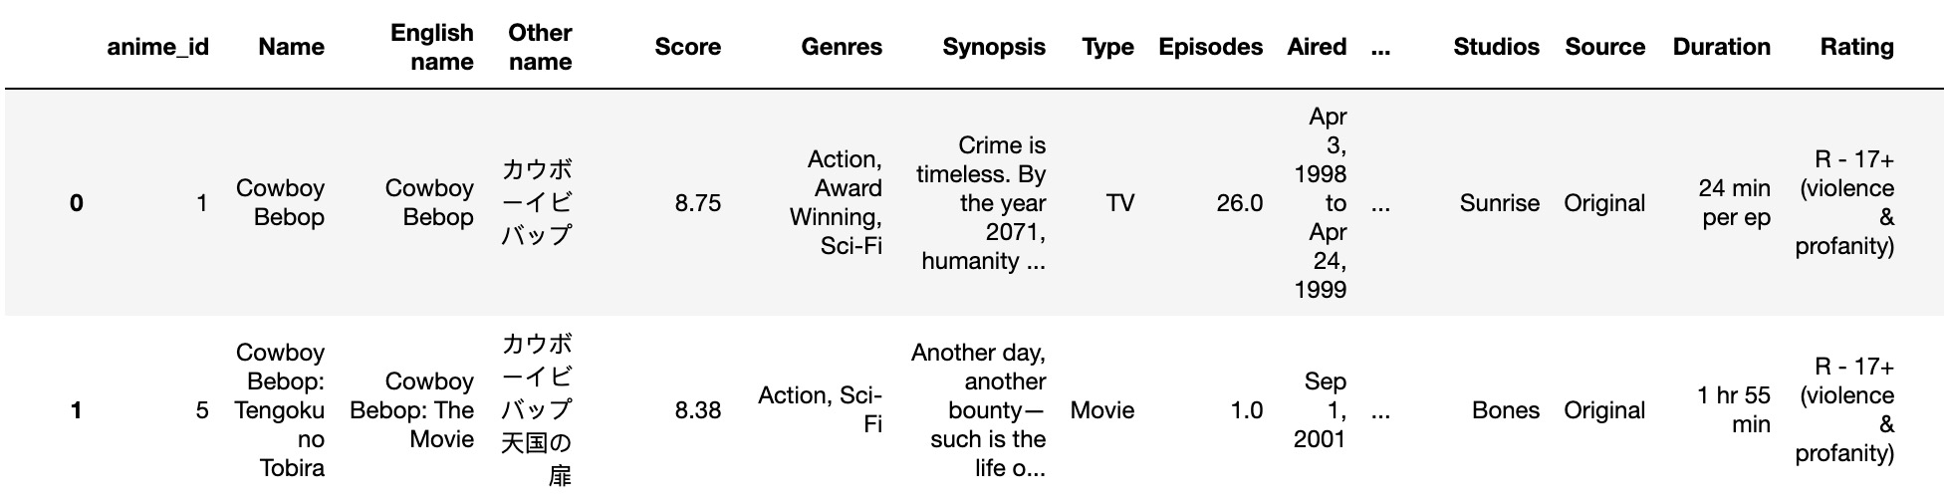
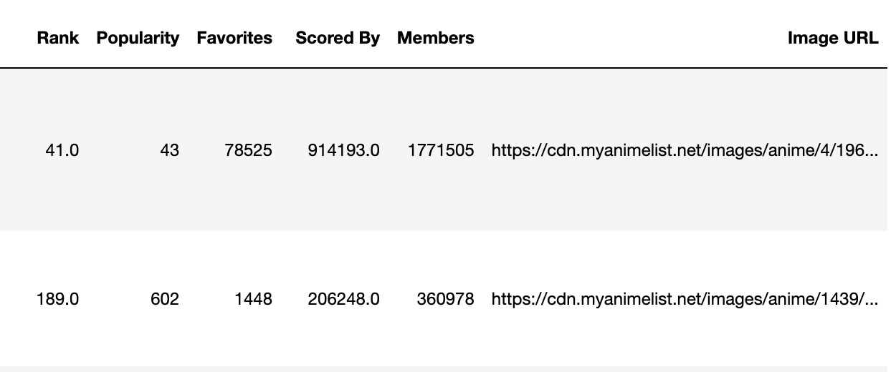
Introduction
Anime Dataset
This dataset collects detailed information about various anime series and movies. It includes data such as the anime's title, average rating, genres, synopsis, format (e.g., TV series or movie), number of episodes, airing status (finished or ongoing), production and licensing companies, animation studios, source material, episode or movie duration, age rating, ranking, popularity, number of times favorited, number of users who have rated the anime, total number of members who have added the anime to their list, and a link to an anime image.

Slide 3
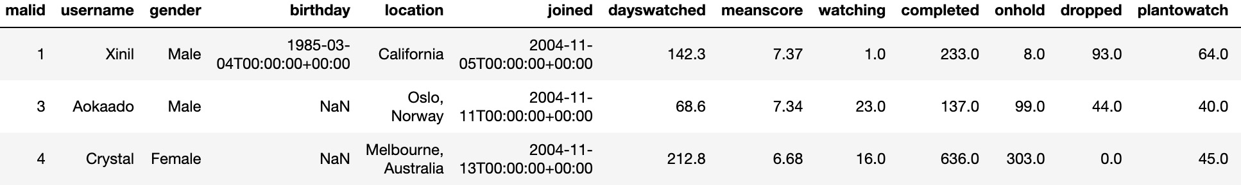
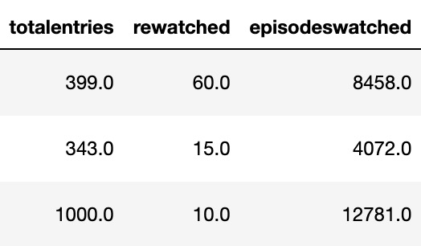
Users Dataset
The users' dataset provides information about users who watch anime, including user ID, username, gender, join date, total days spent watching anime, the average rating given by the user, number of series currently being watched, number of series completed, number of series put on hold, number of series dropped, number of series planned to watch, the total number of anime entries logged by the user, number of series rewatched, and the total number of episodes watched. This information can help understand user-watching habits, rating preferences, and overall anime consumption behavior.

Slide 4
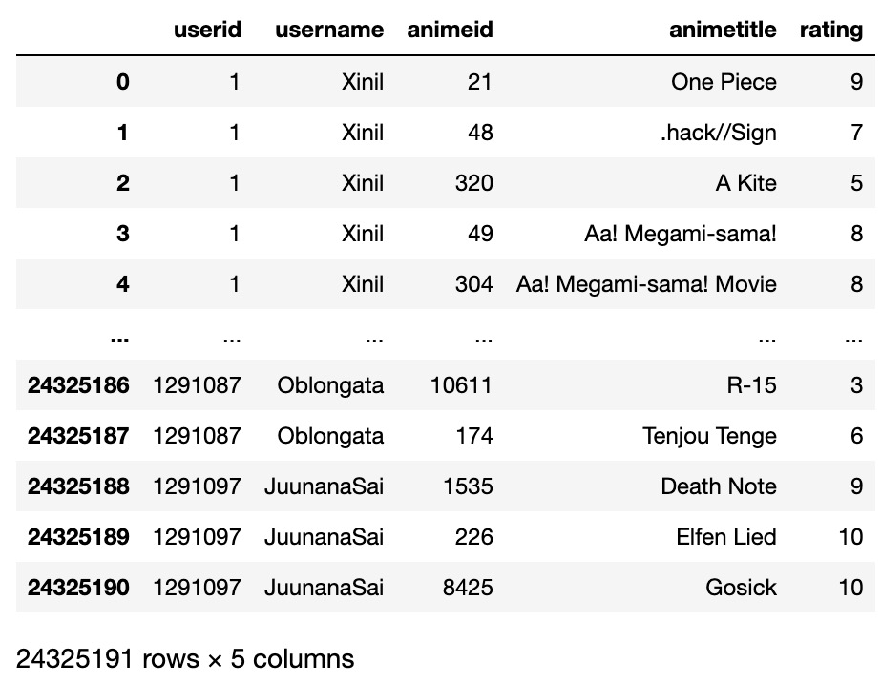
User Anime Ratings Dataset
This dataset is a collection of user-submitted ratings for various anime titles. It is structured to capture the interaction between users and the anime they watch, specifically how users rate these titles.

Slide 5
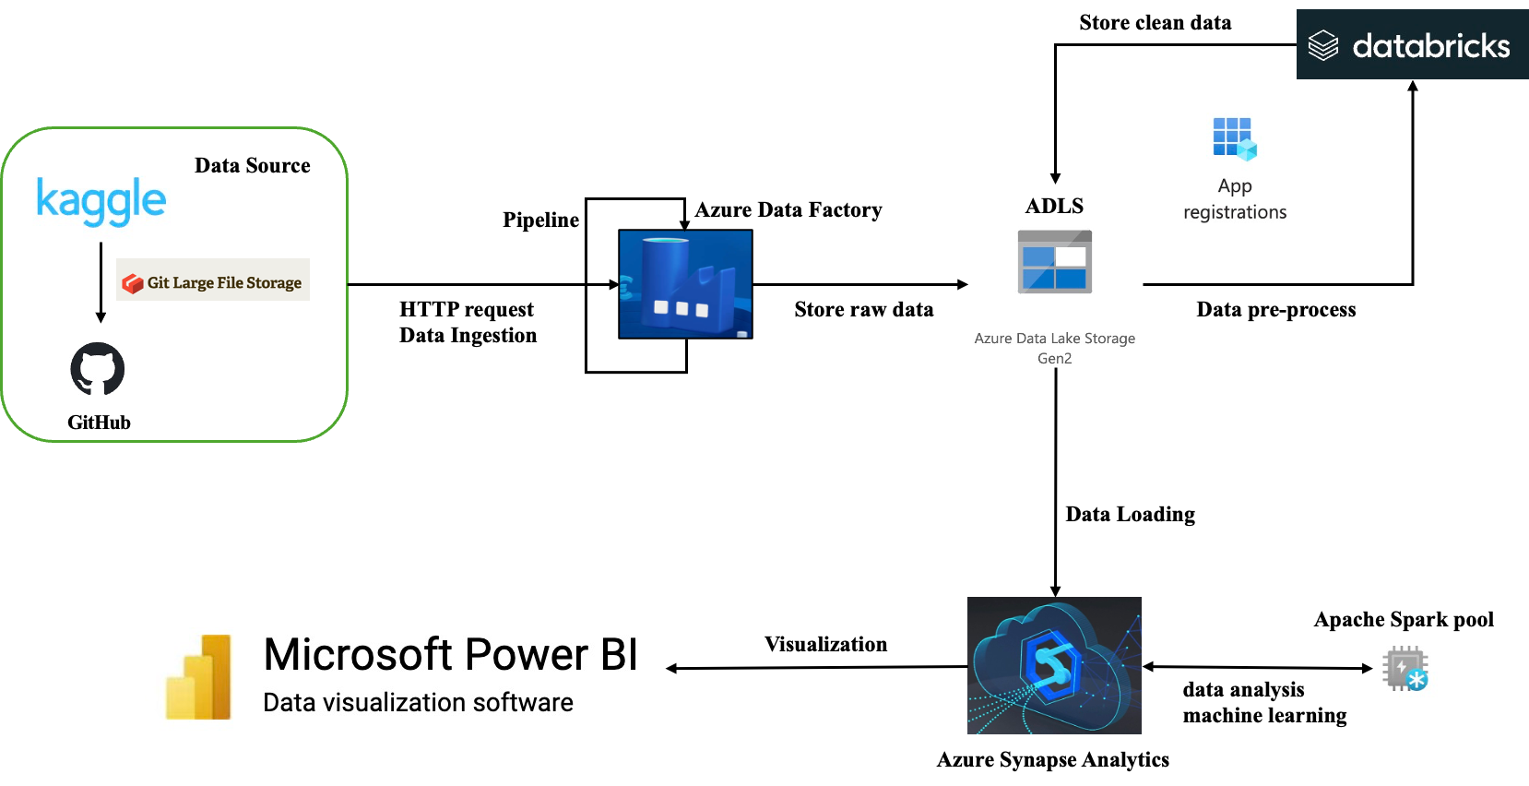
Architecture

Slide 6
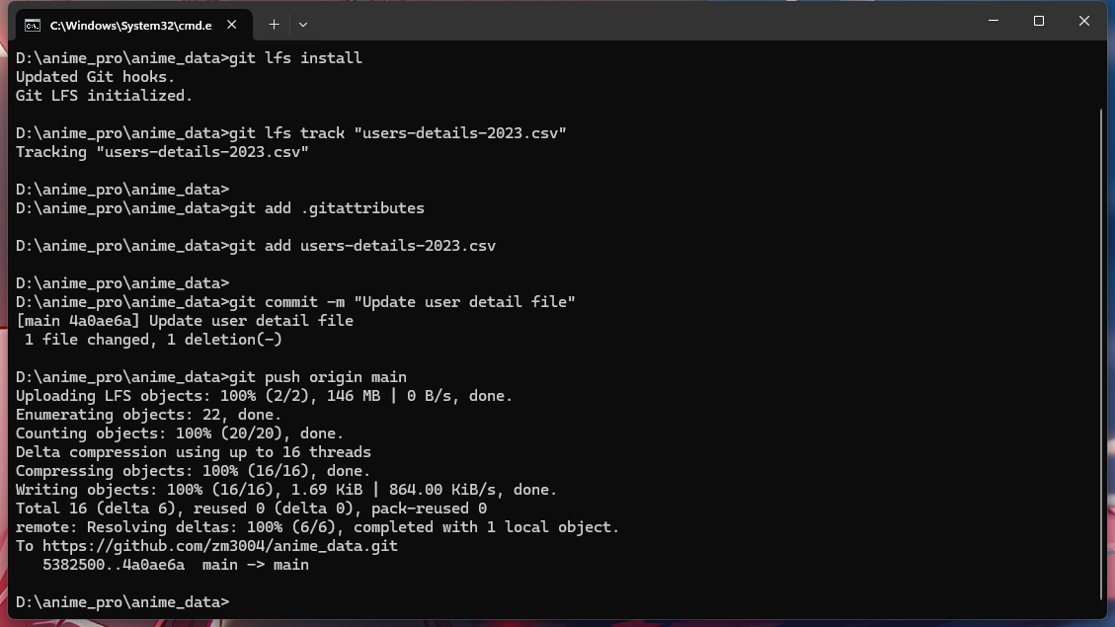
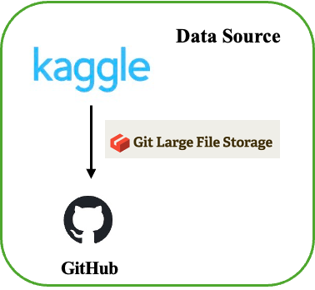
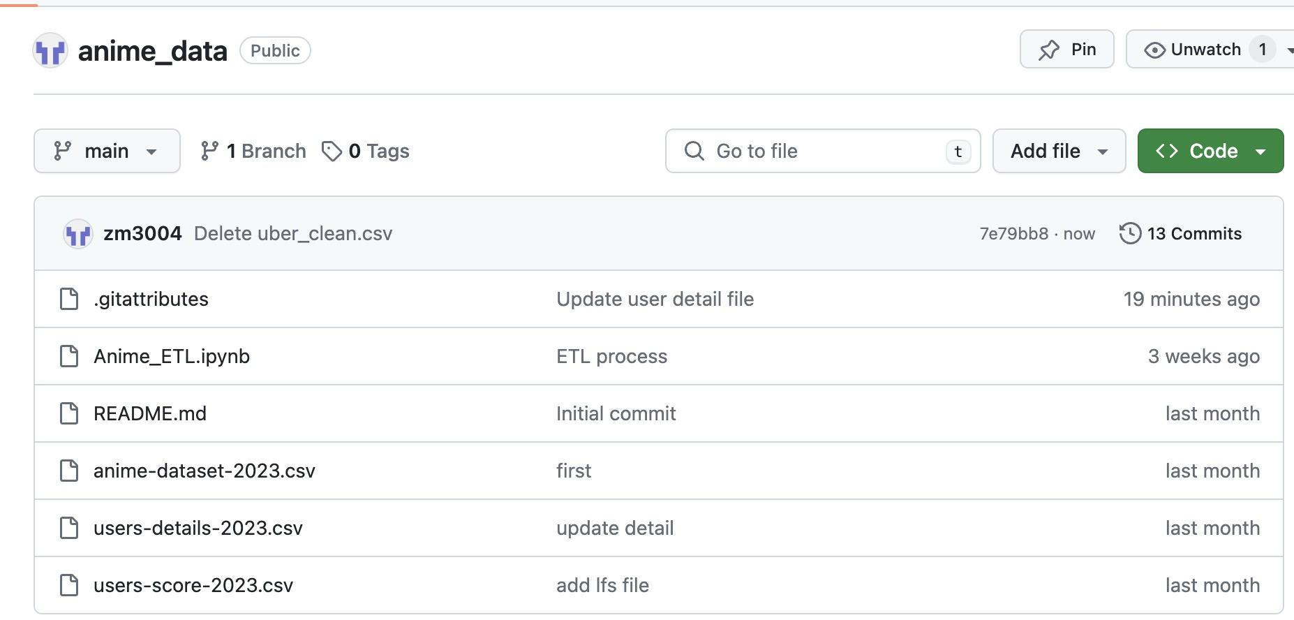

Slide 7
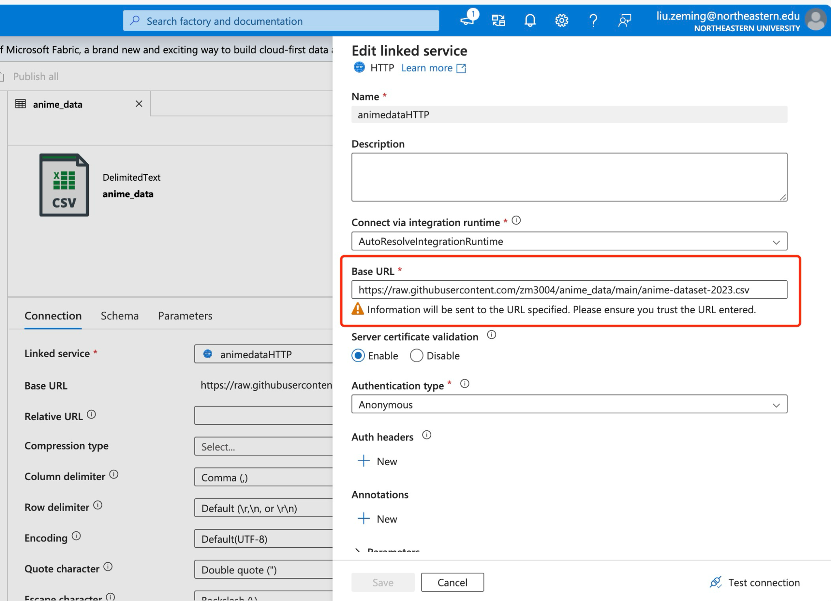
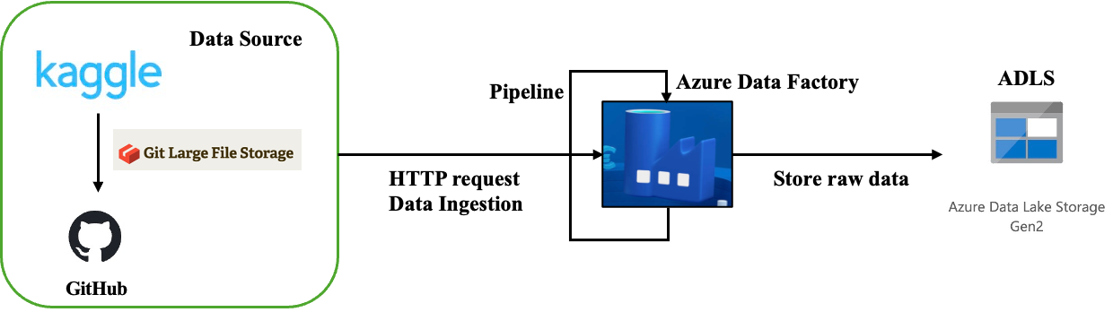
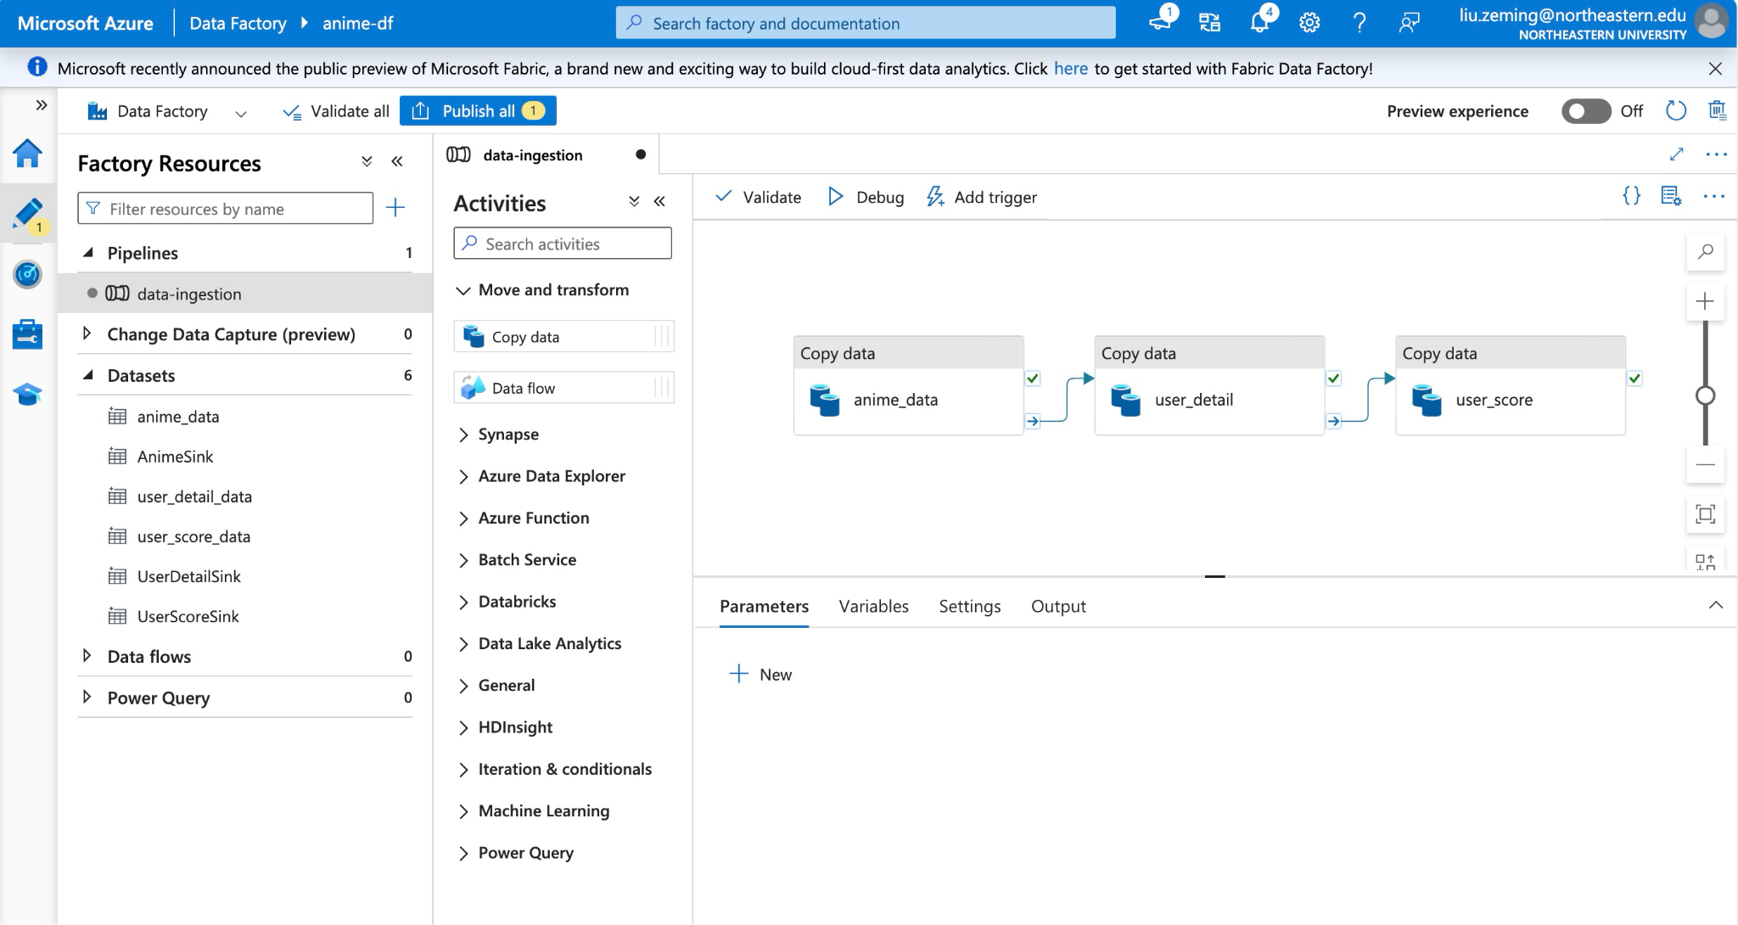
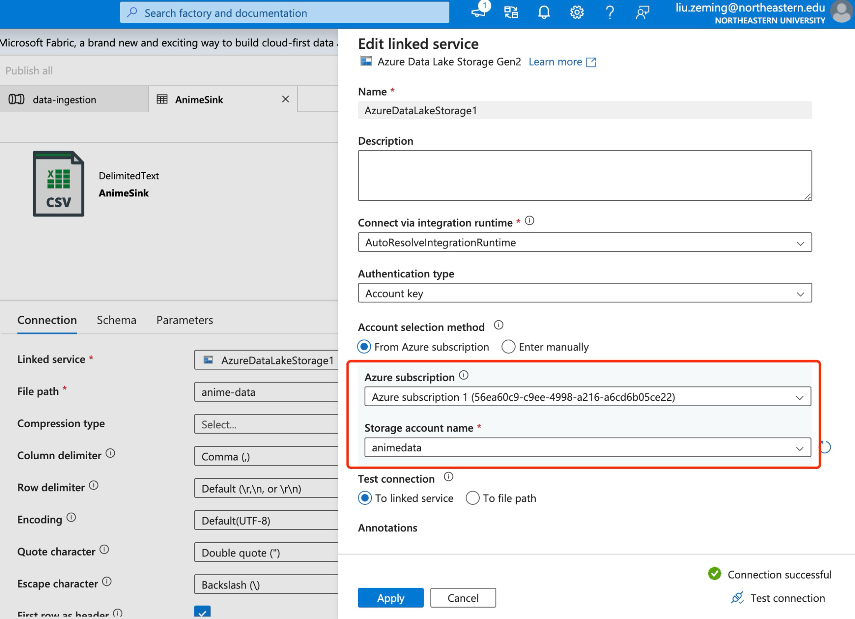

Slide 8
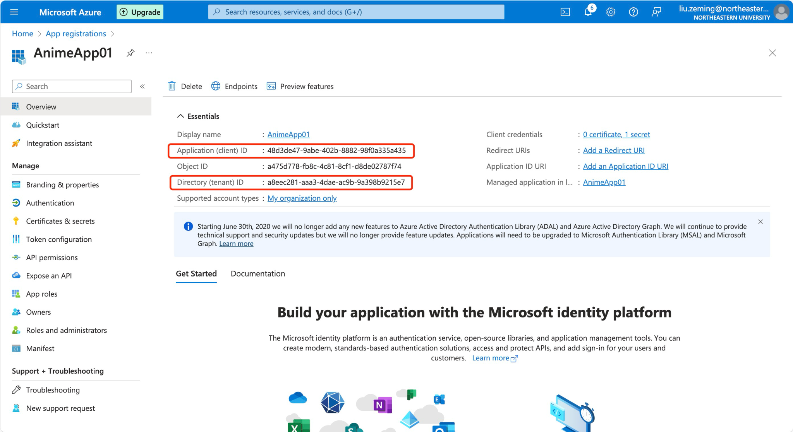
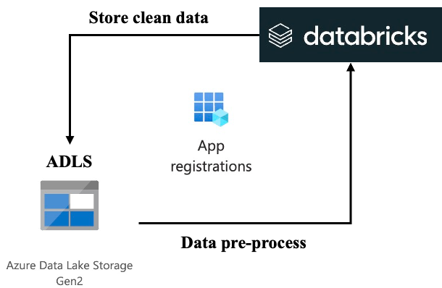
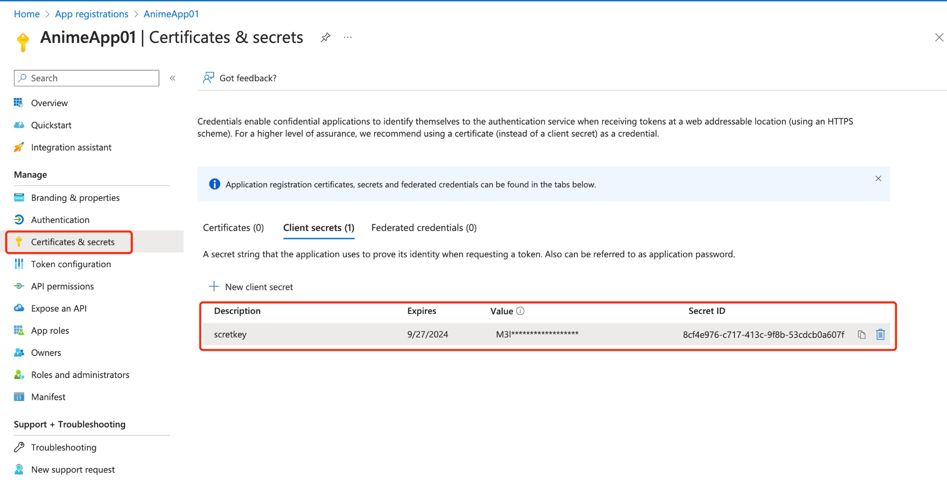

Slide 9
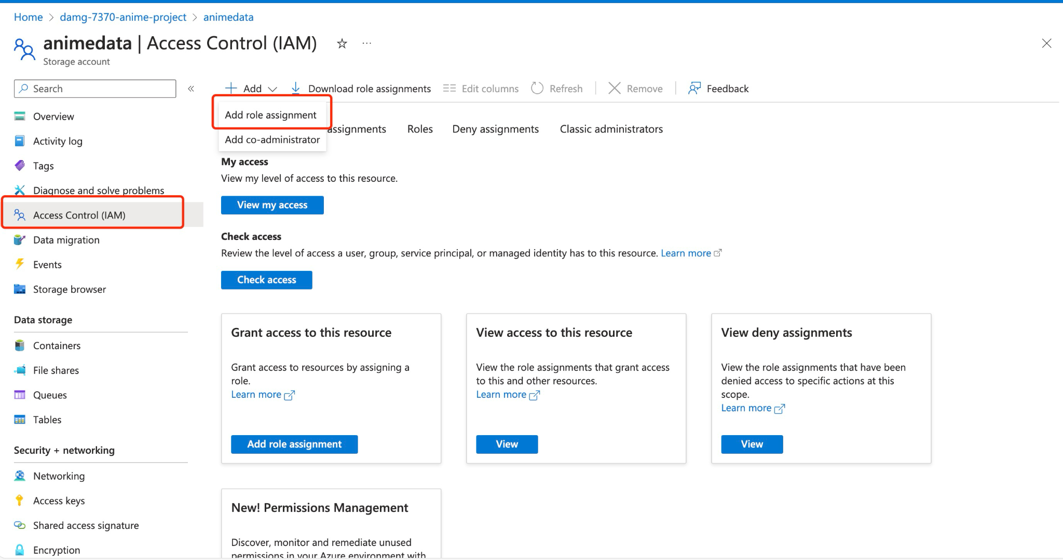
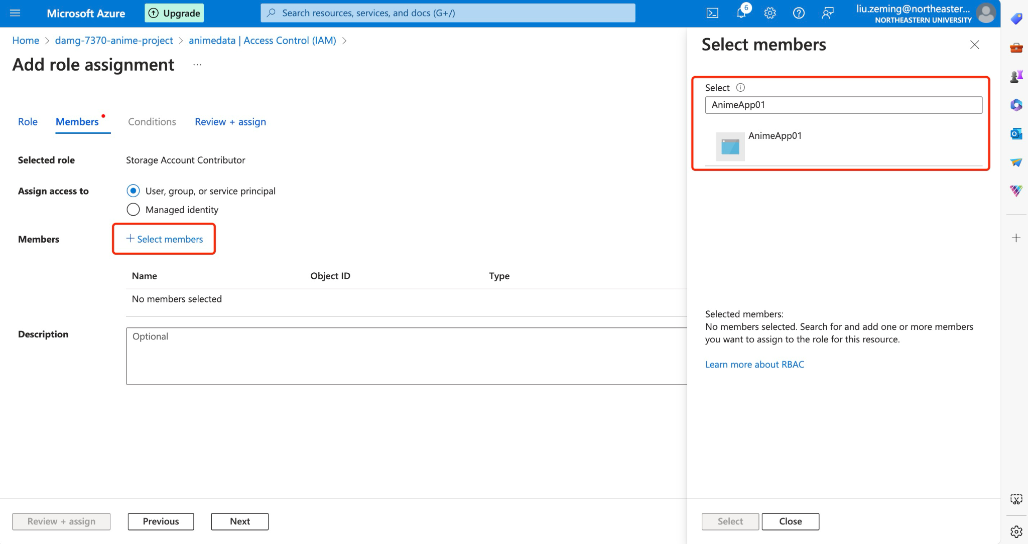
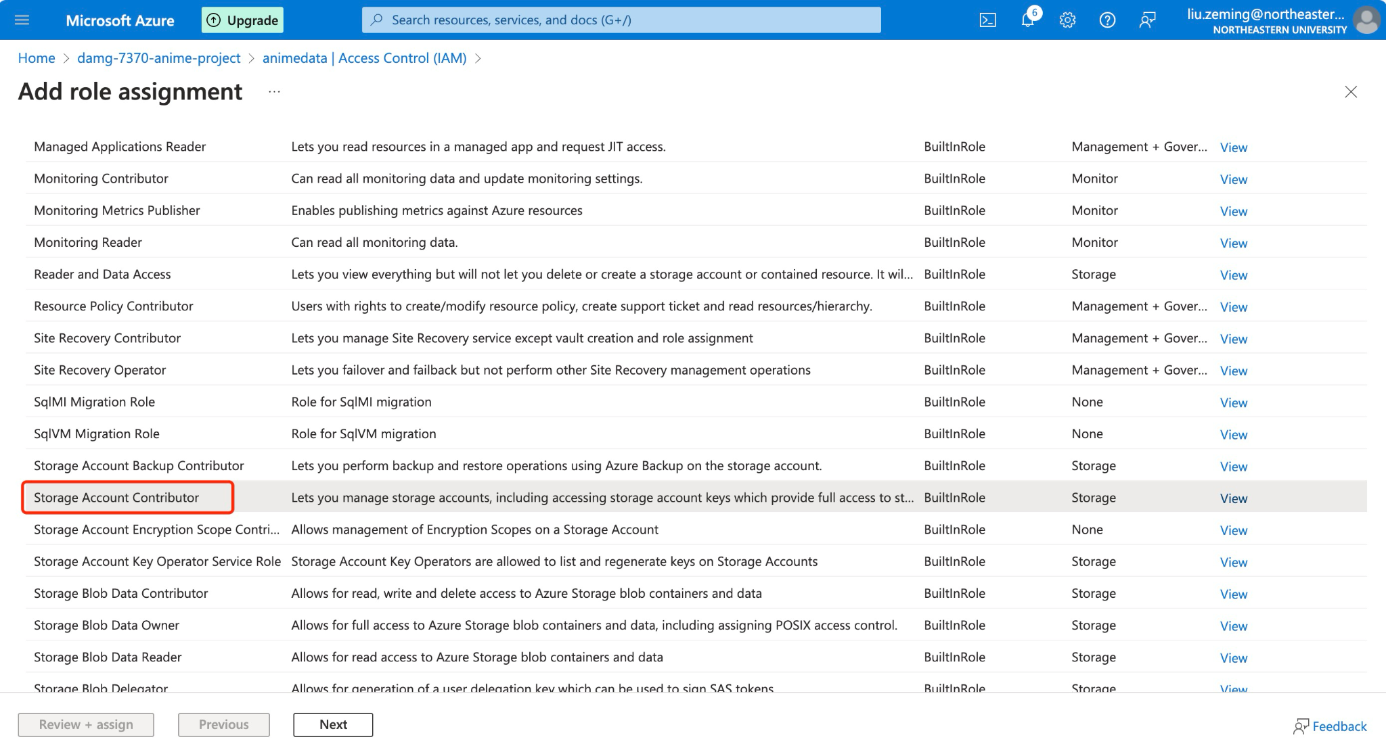

Slide 10
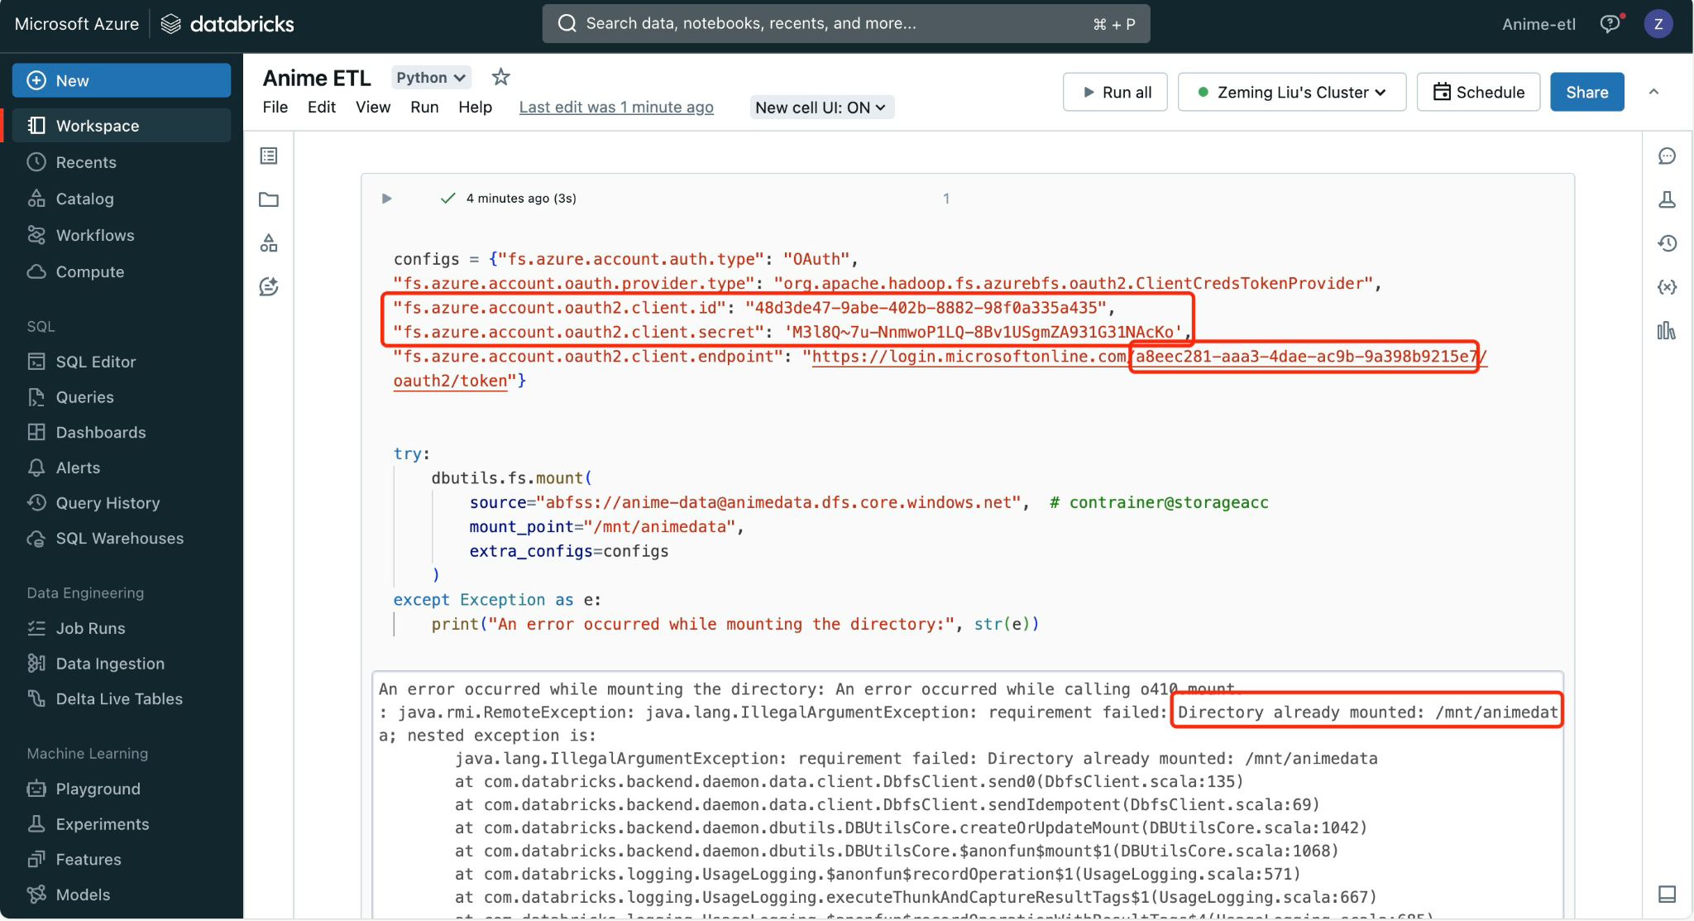

Slide 11
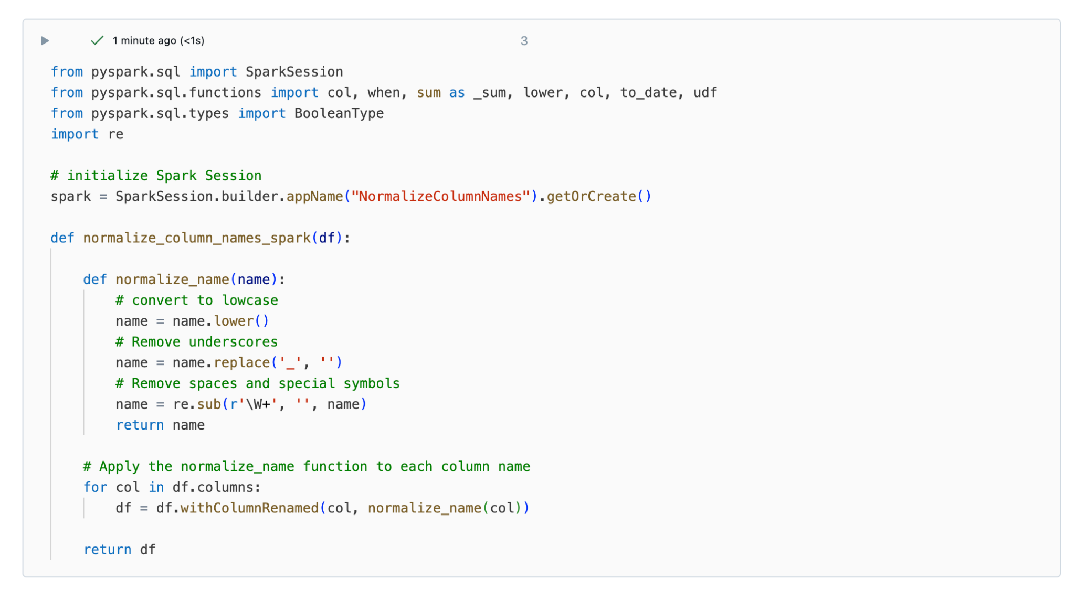
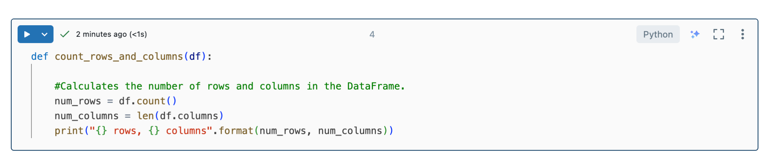
Pre-process

Slide 12
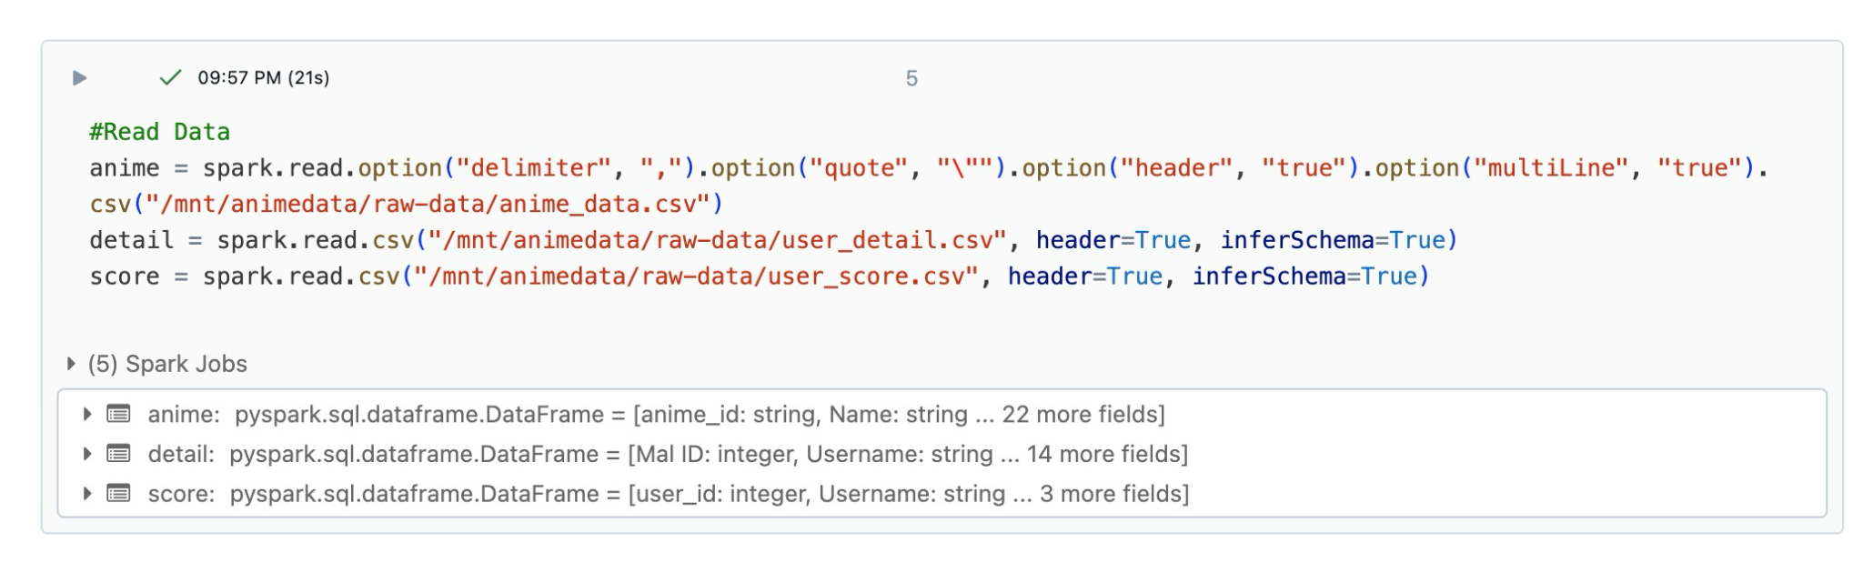
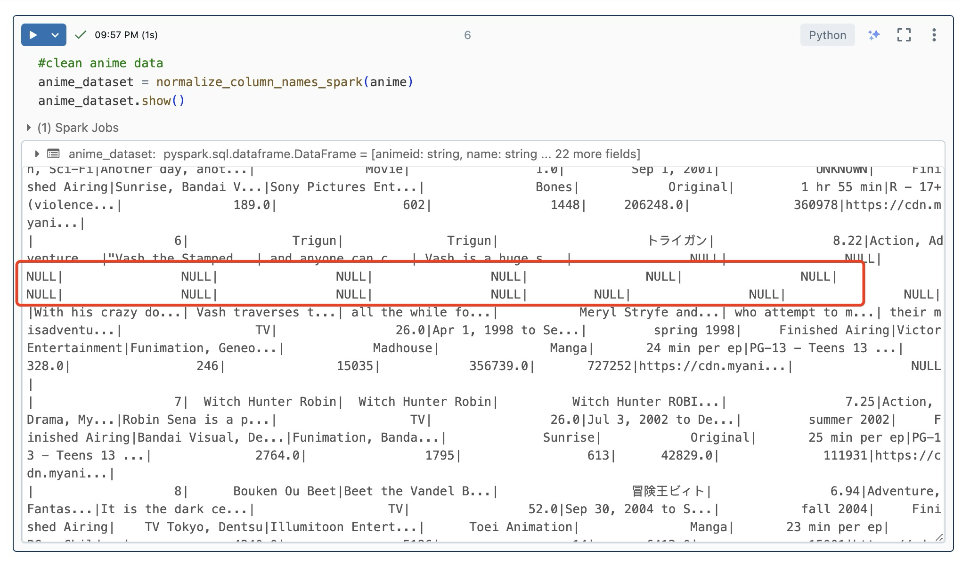
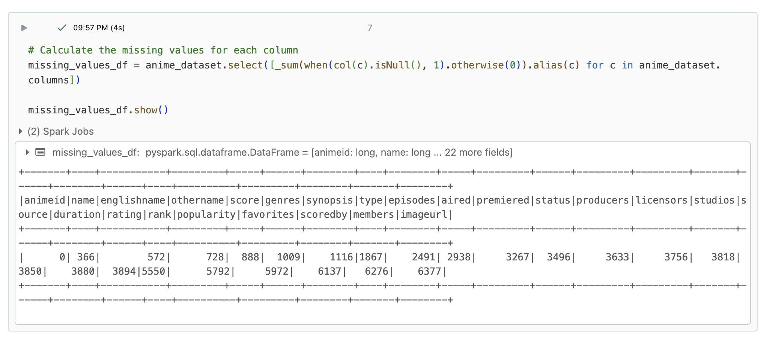
Anime Dataset

Slide 13
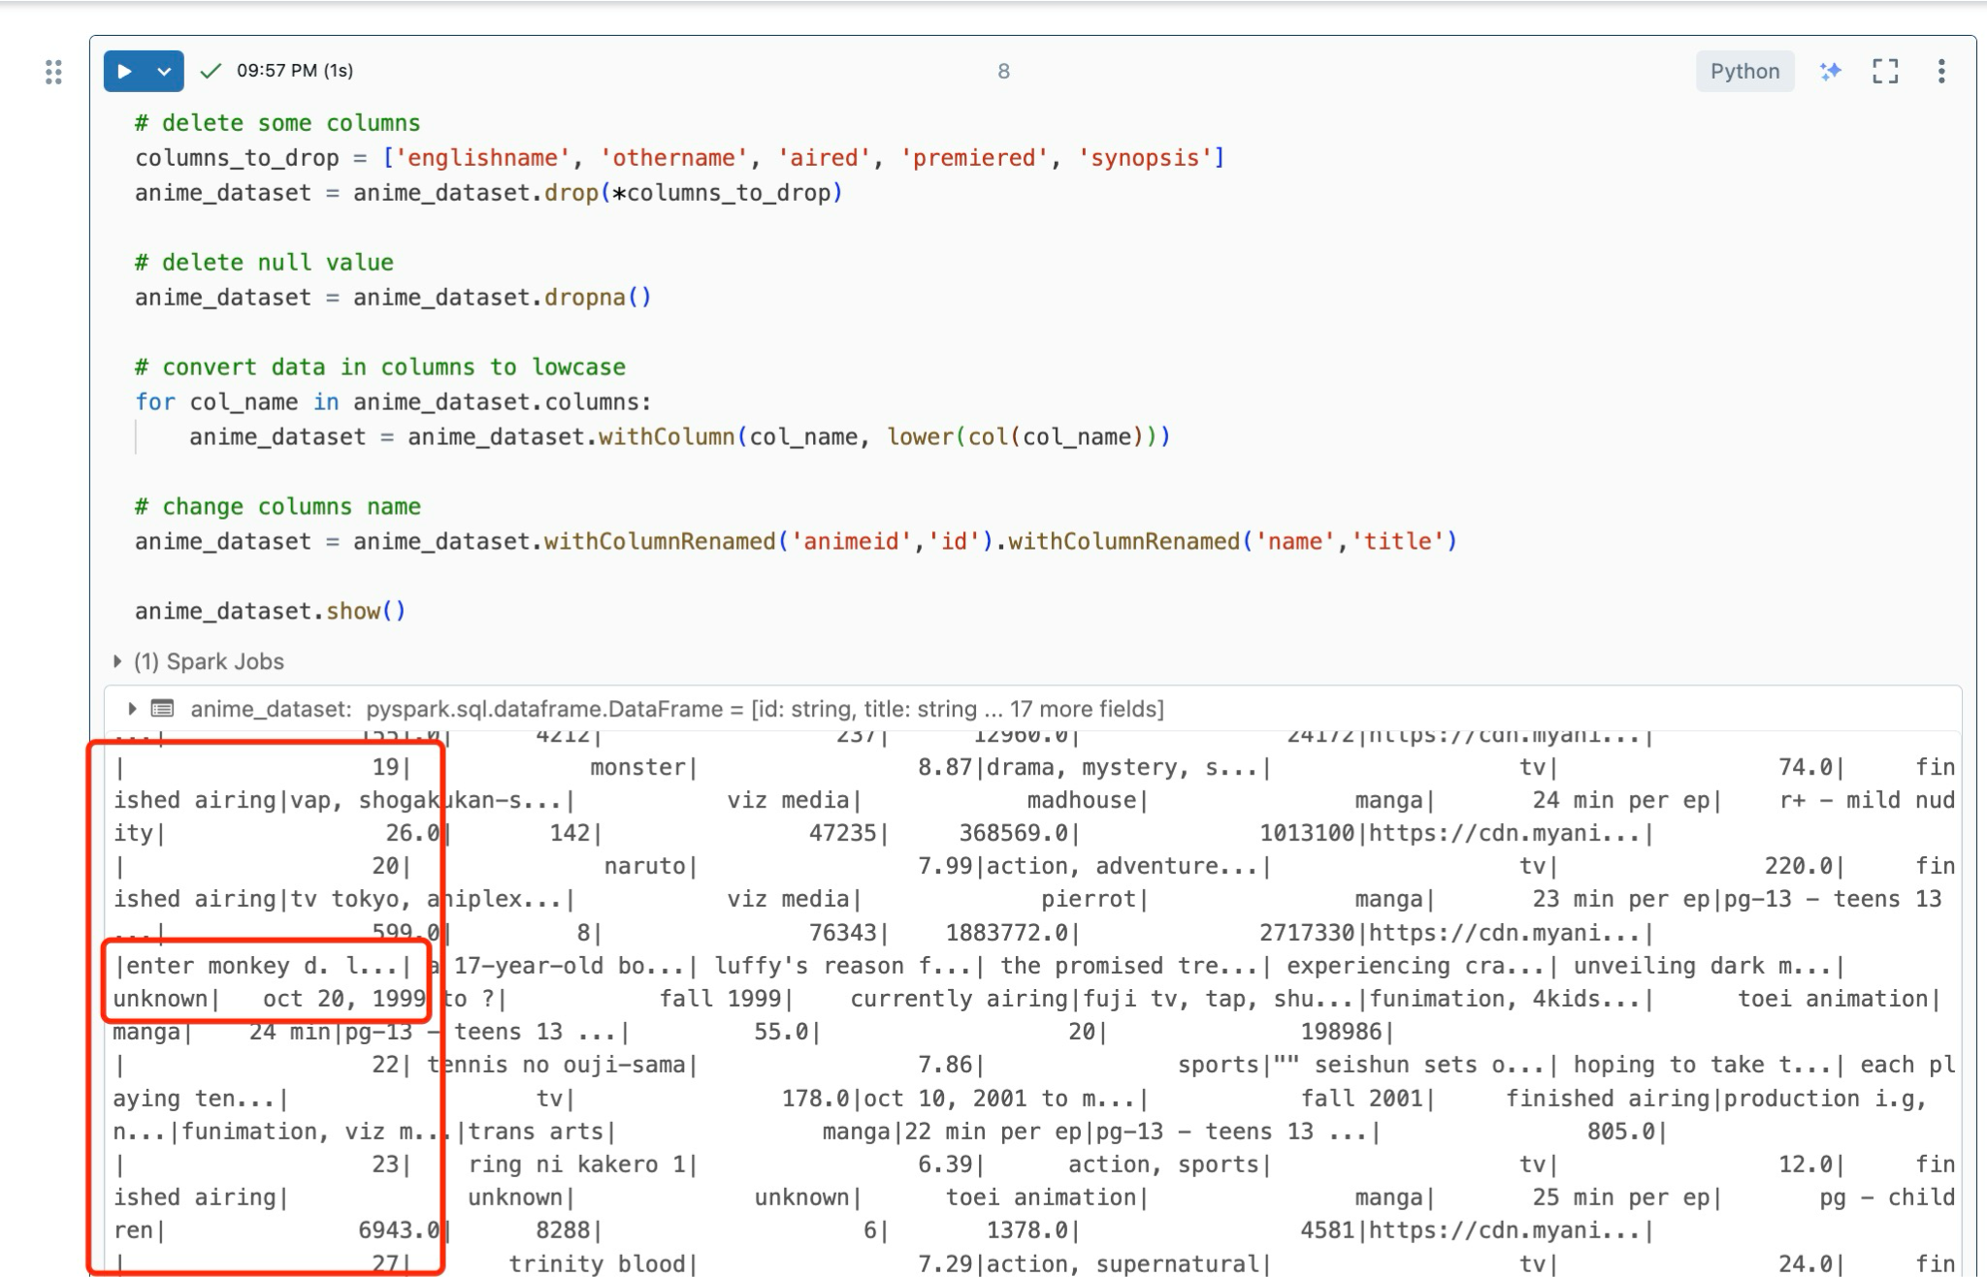
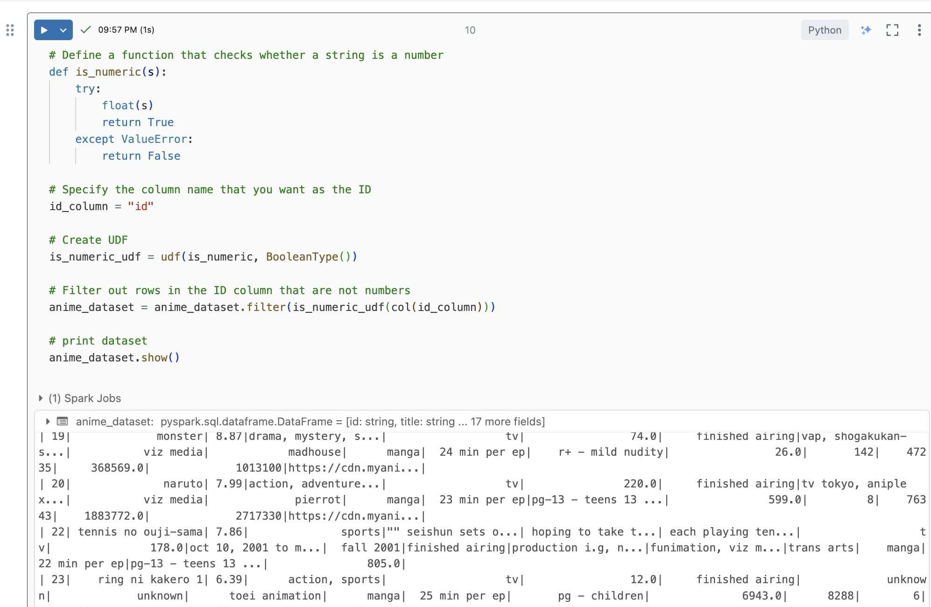
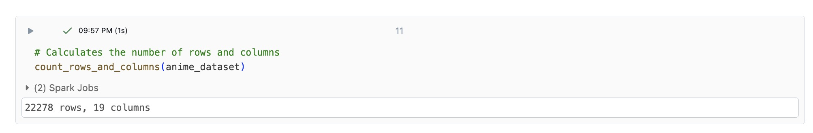

Slide 14
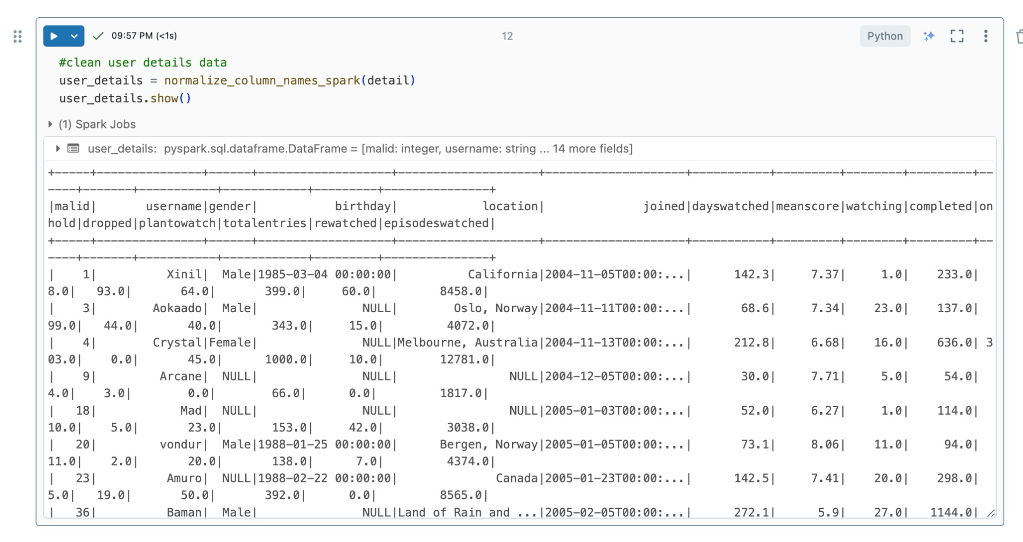
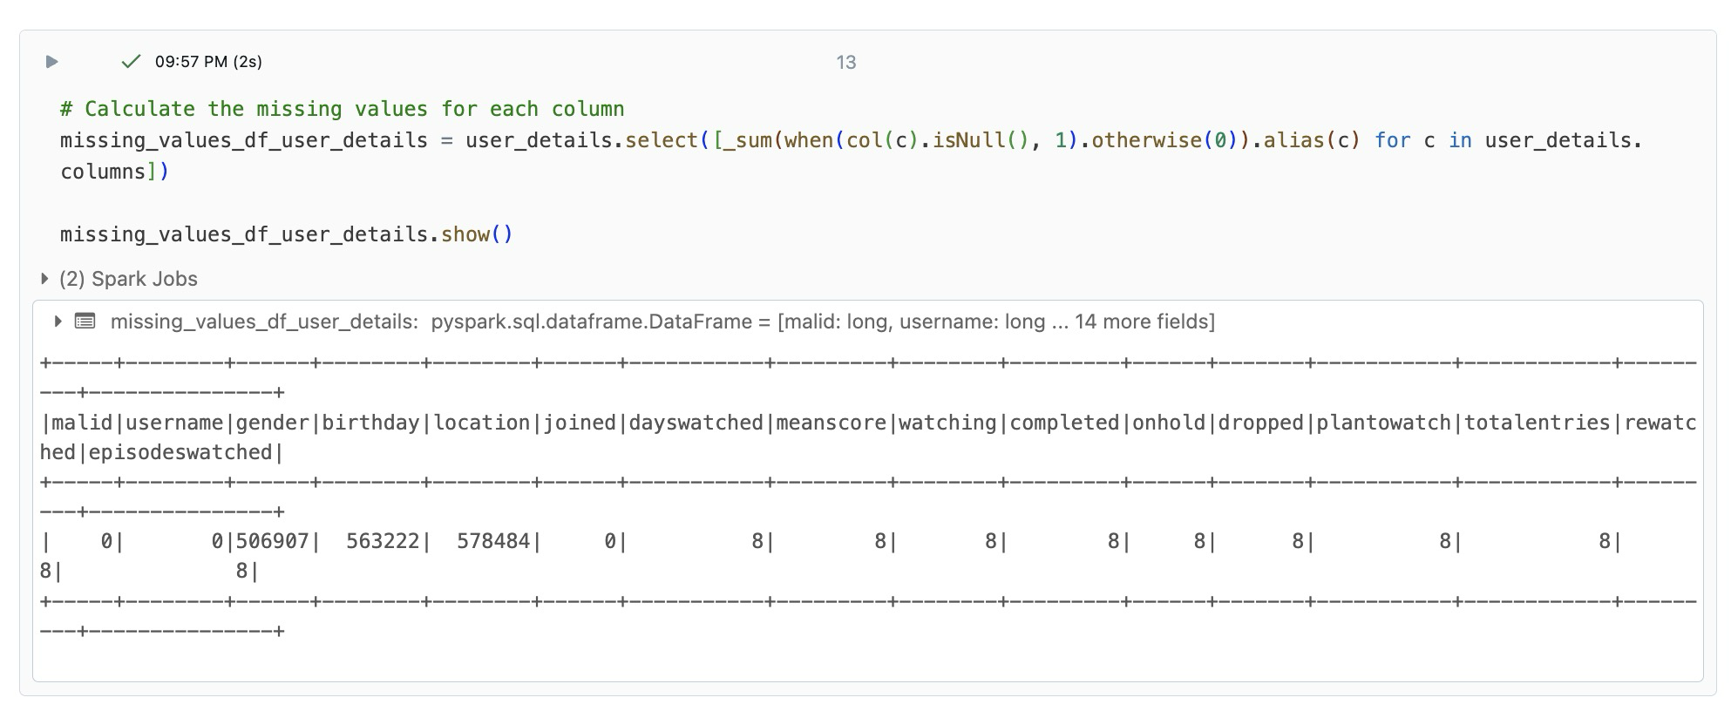
User Detail

Slide 15
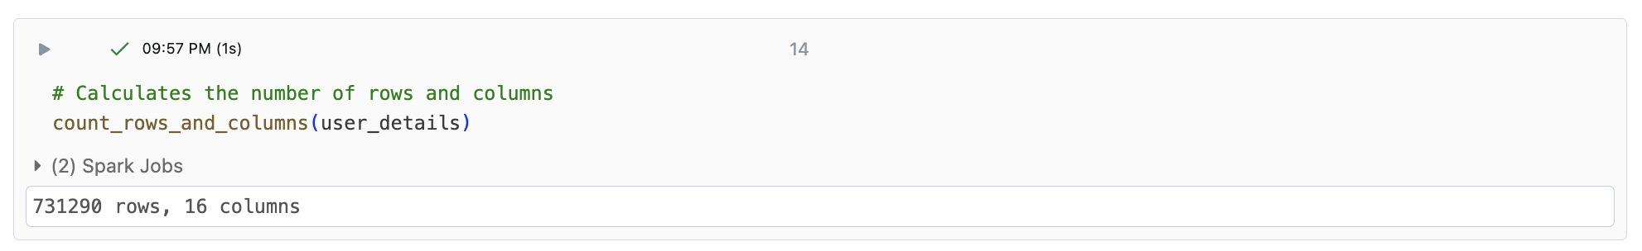
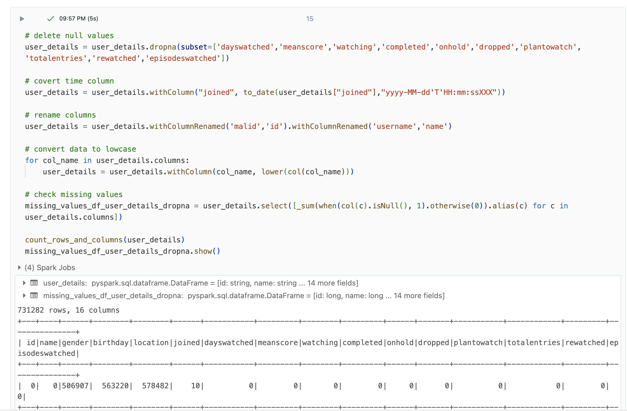

Slide 16
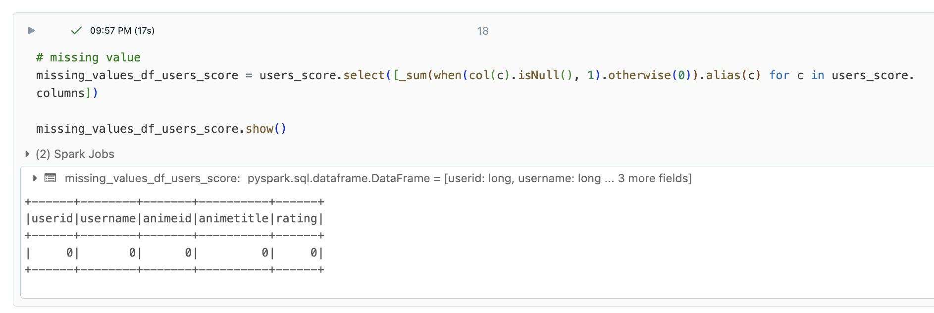
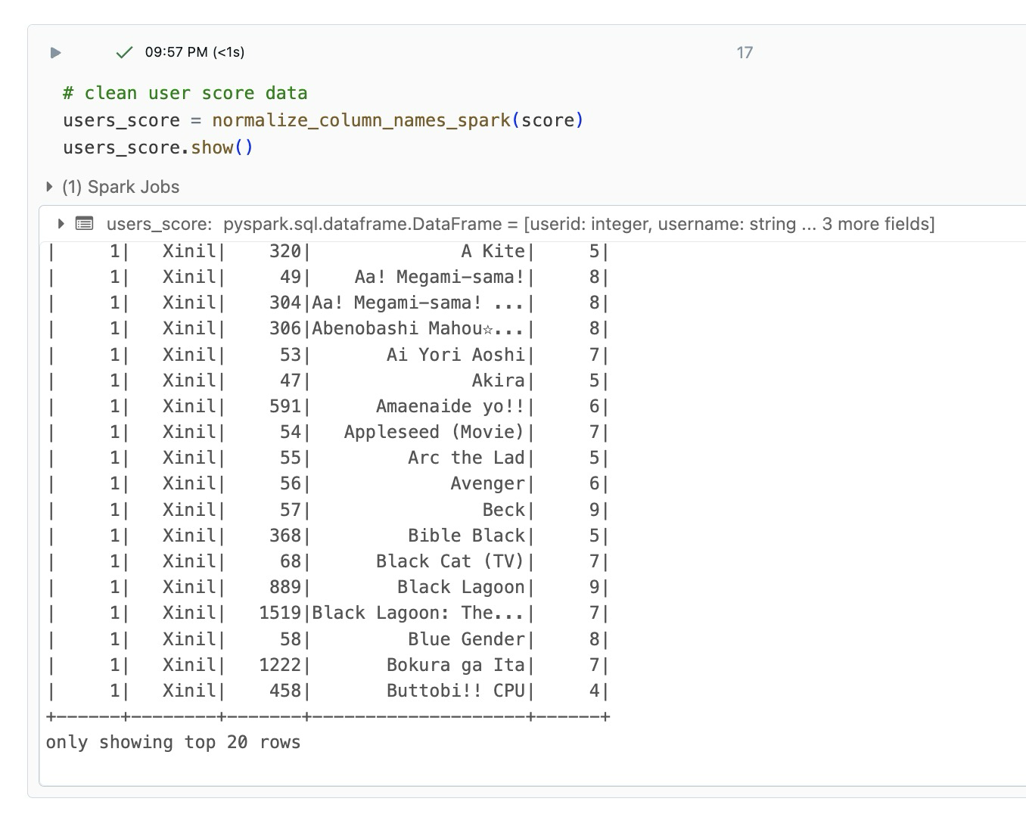
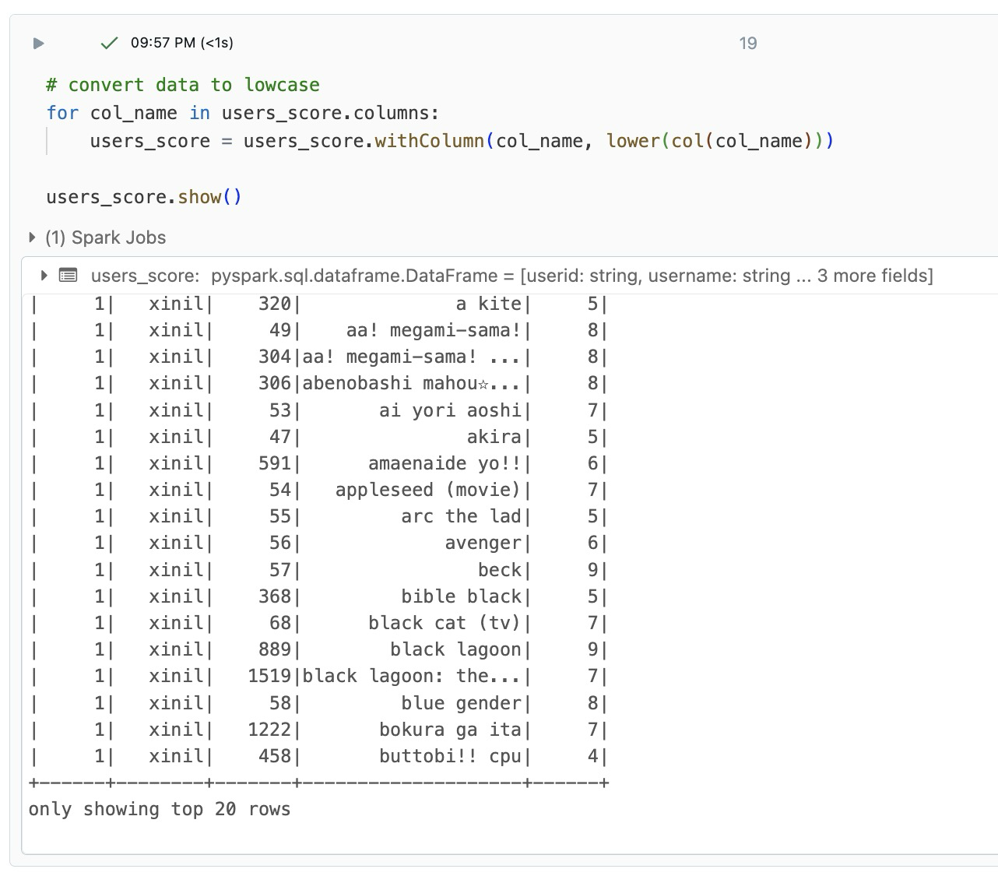
User Score

Slide 17
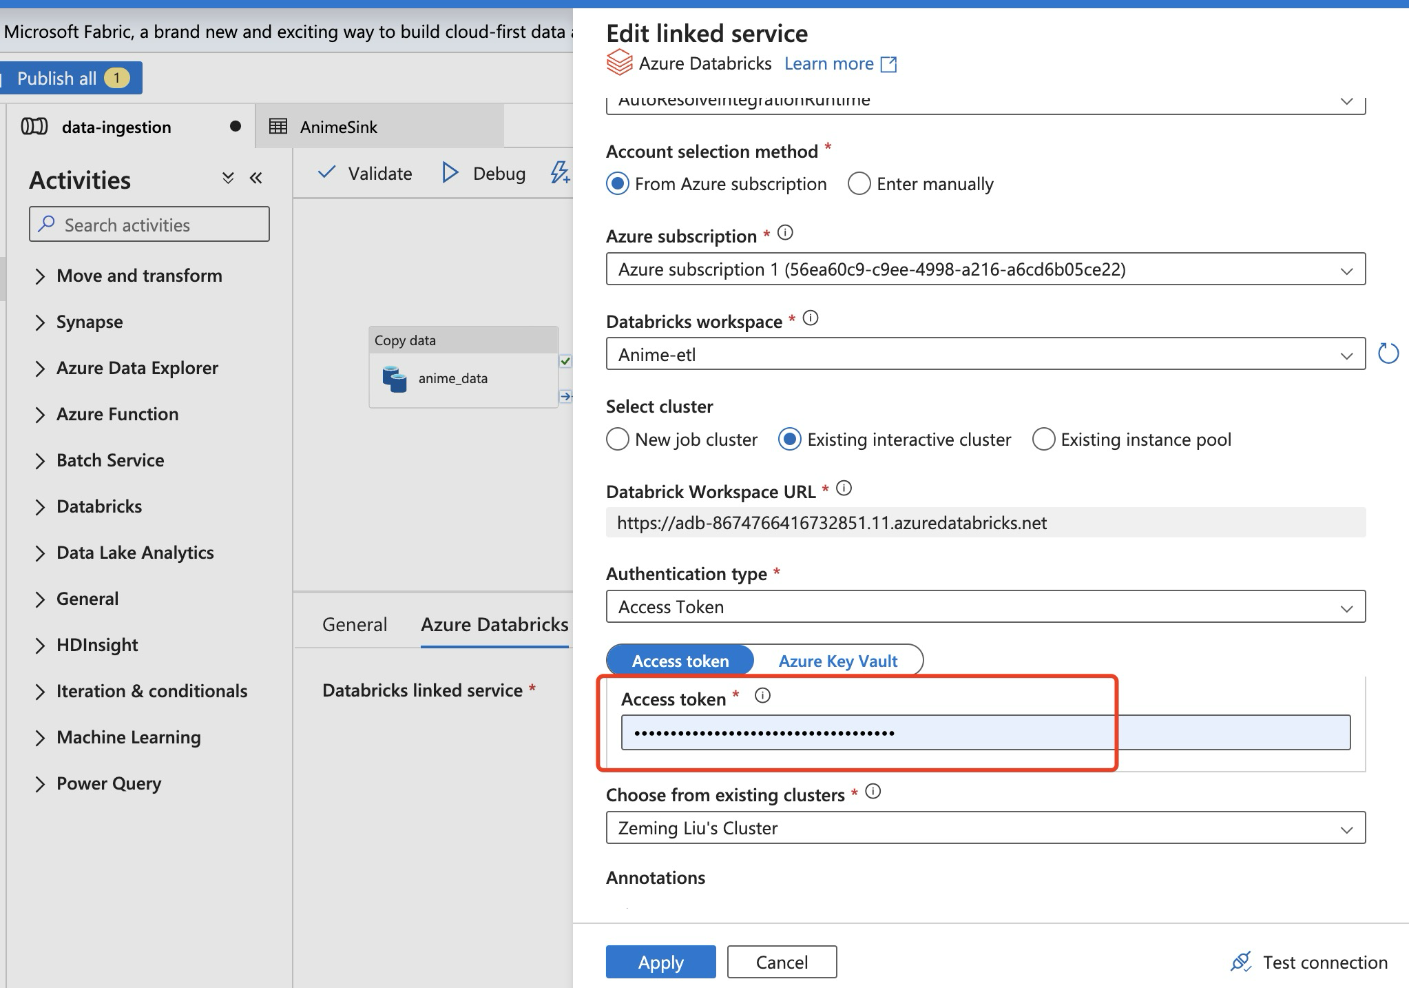
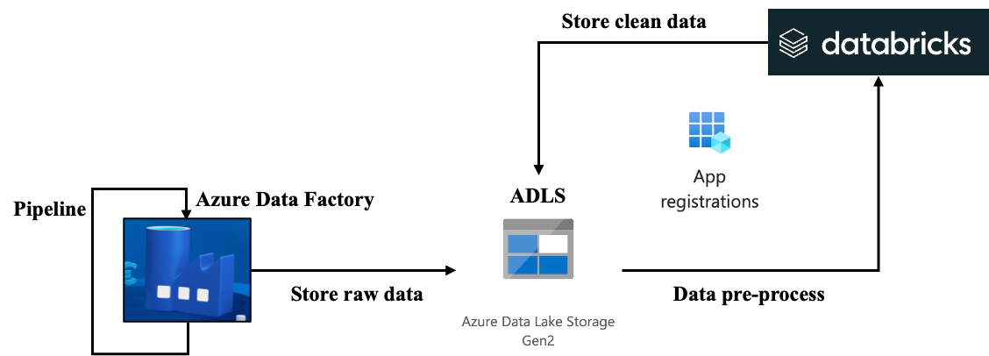
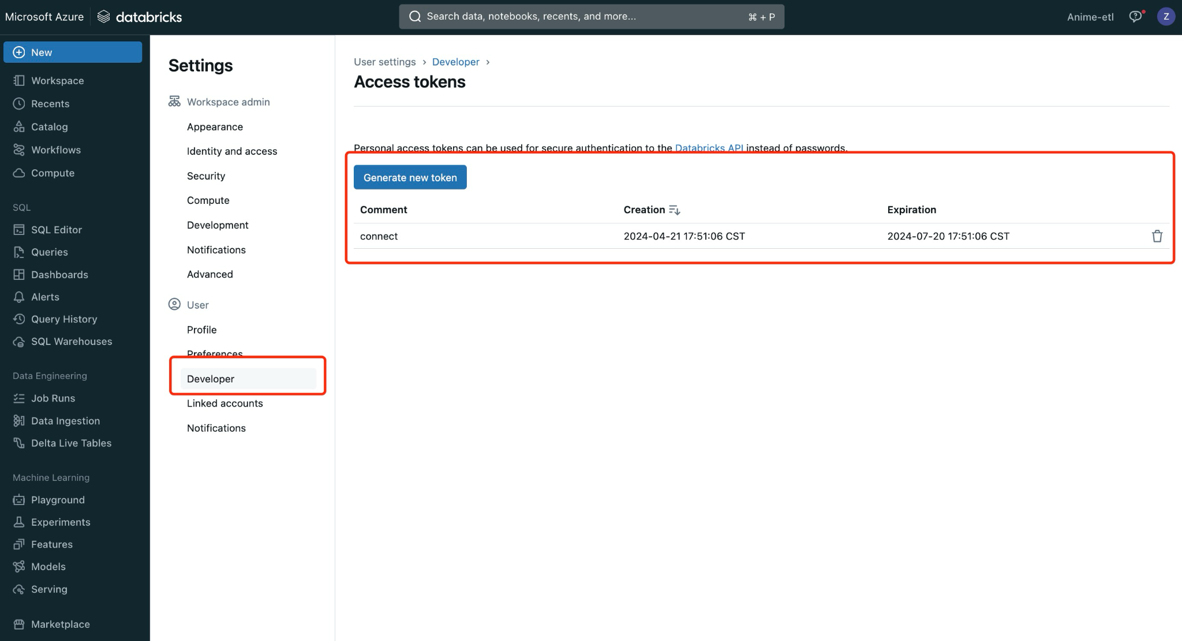
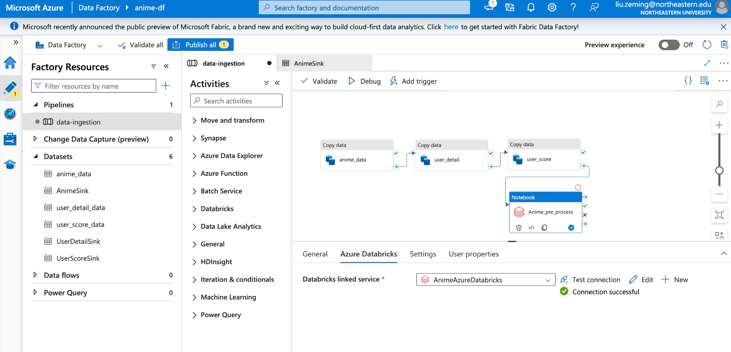

Slide 18
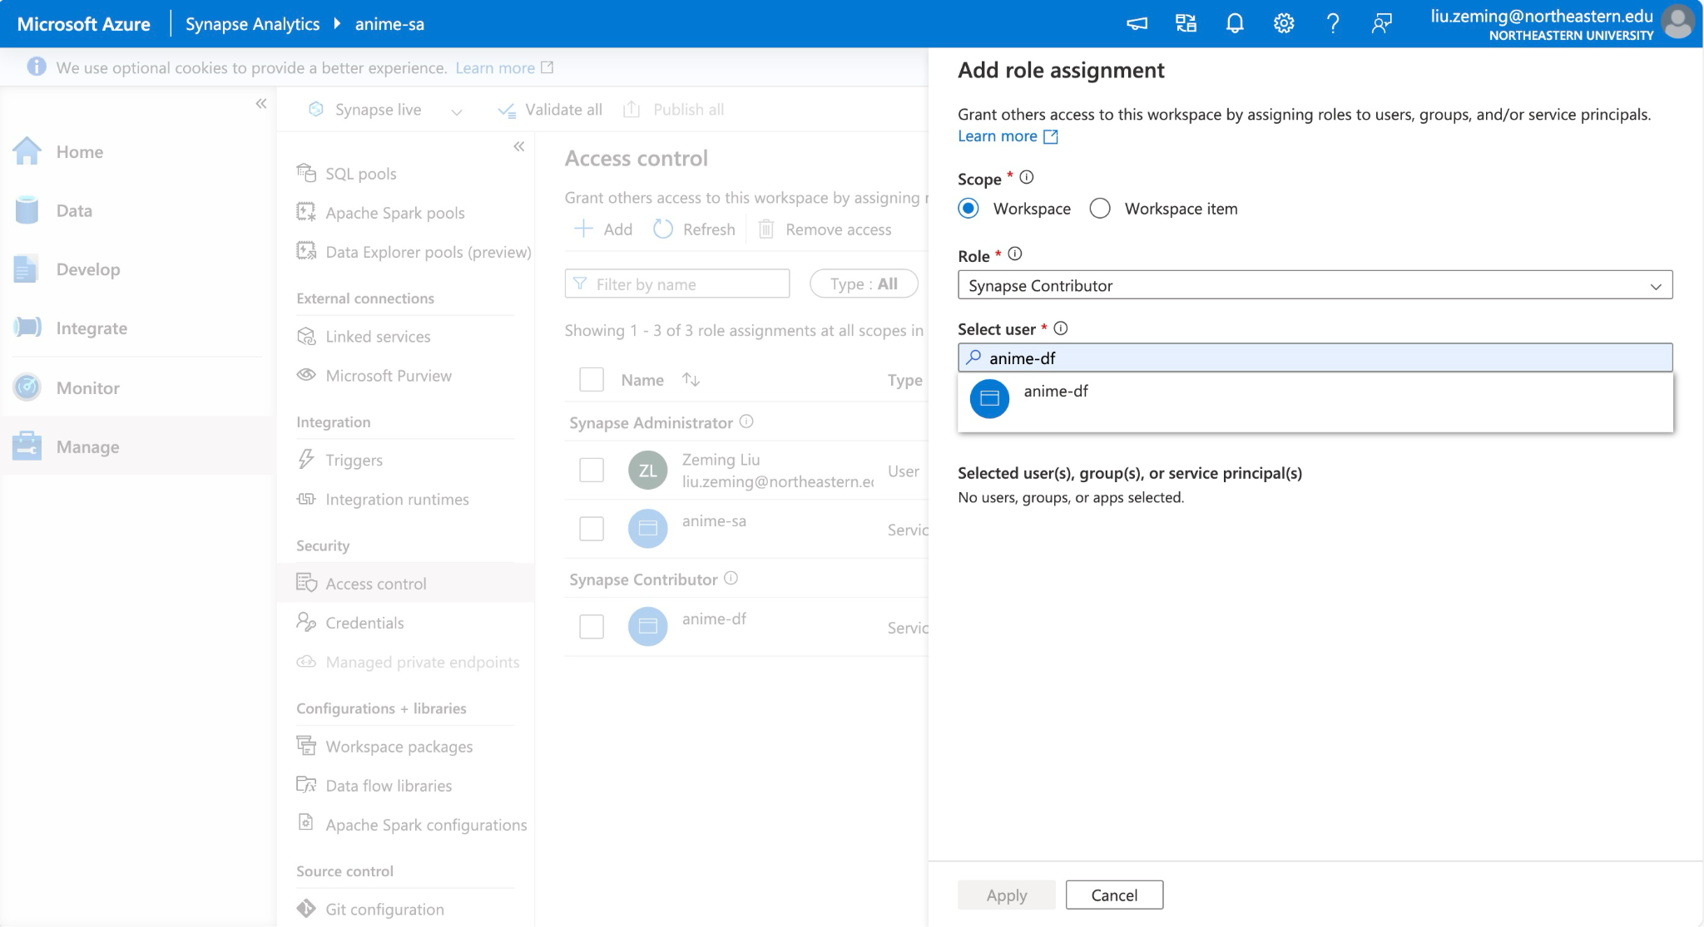
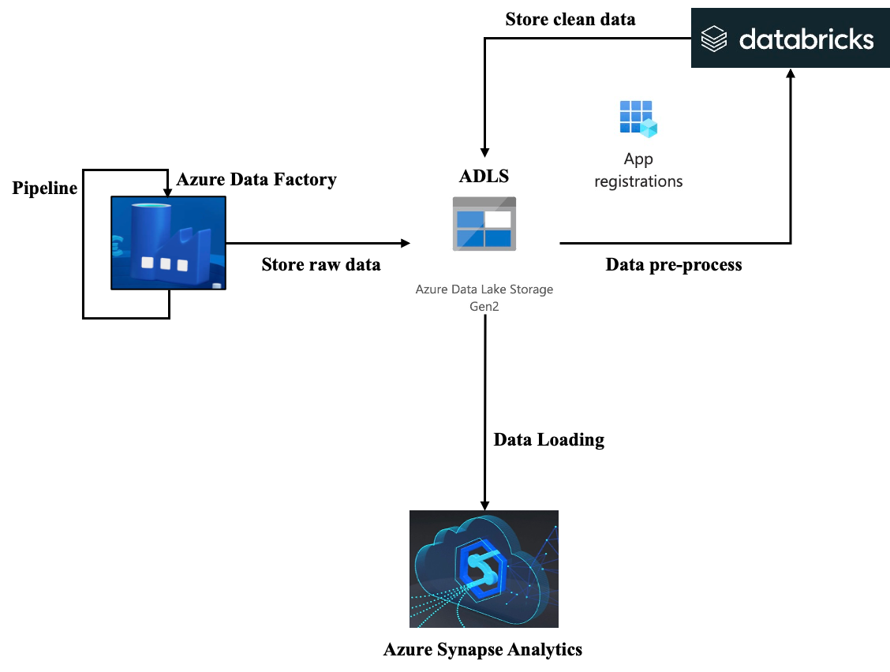
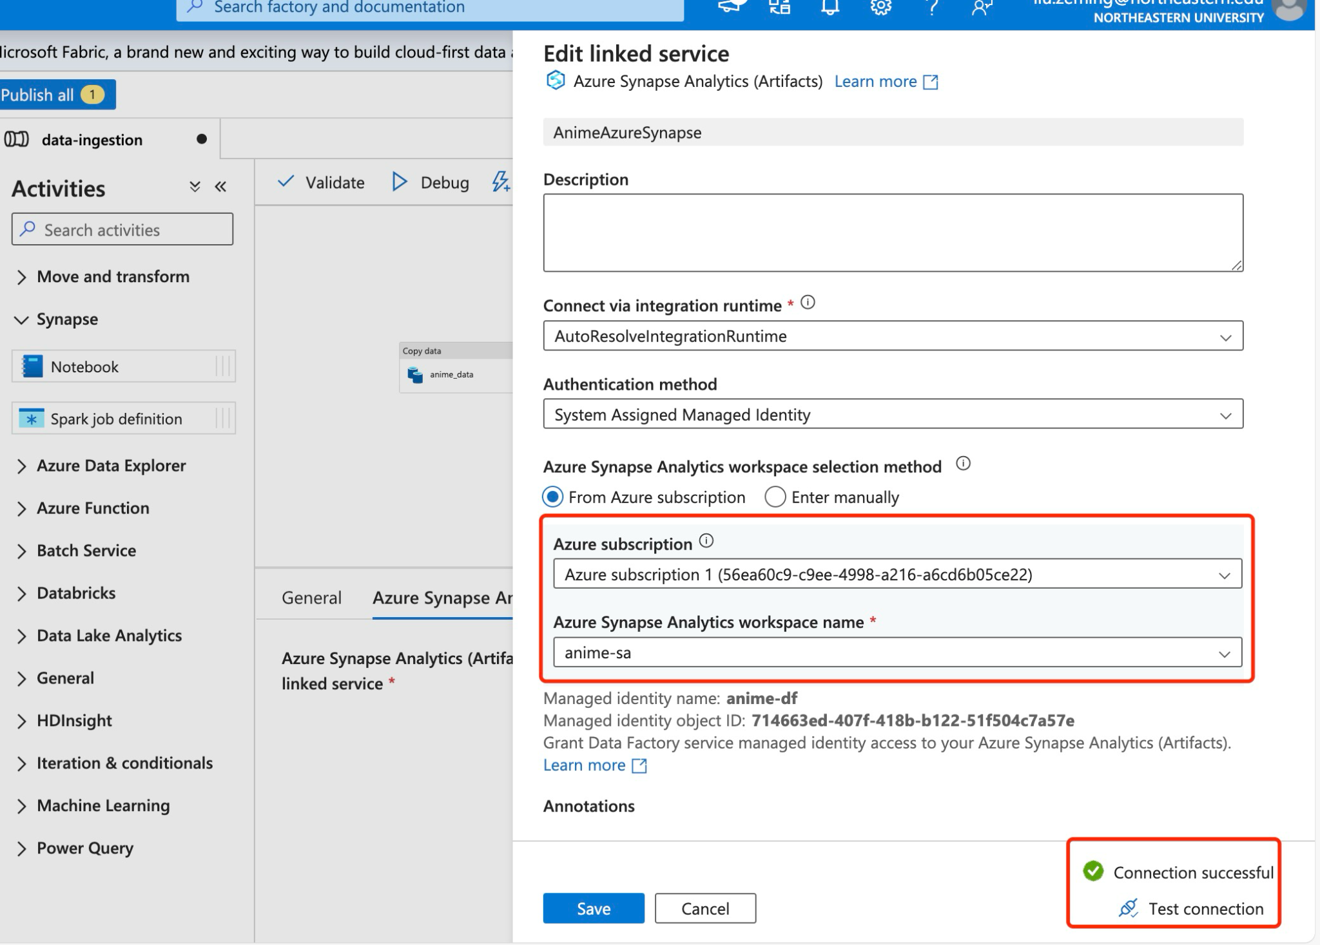
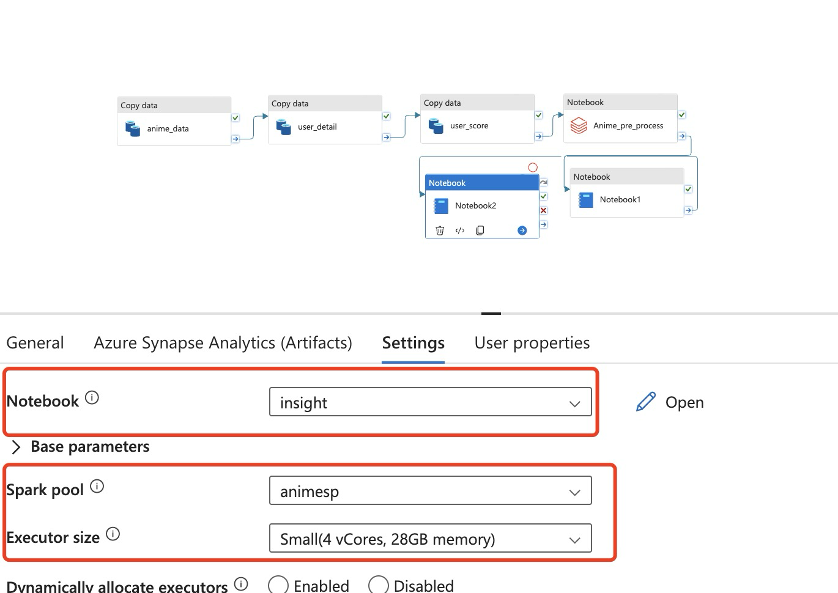

Slide 19
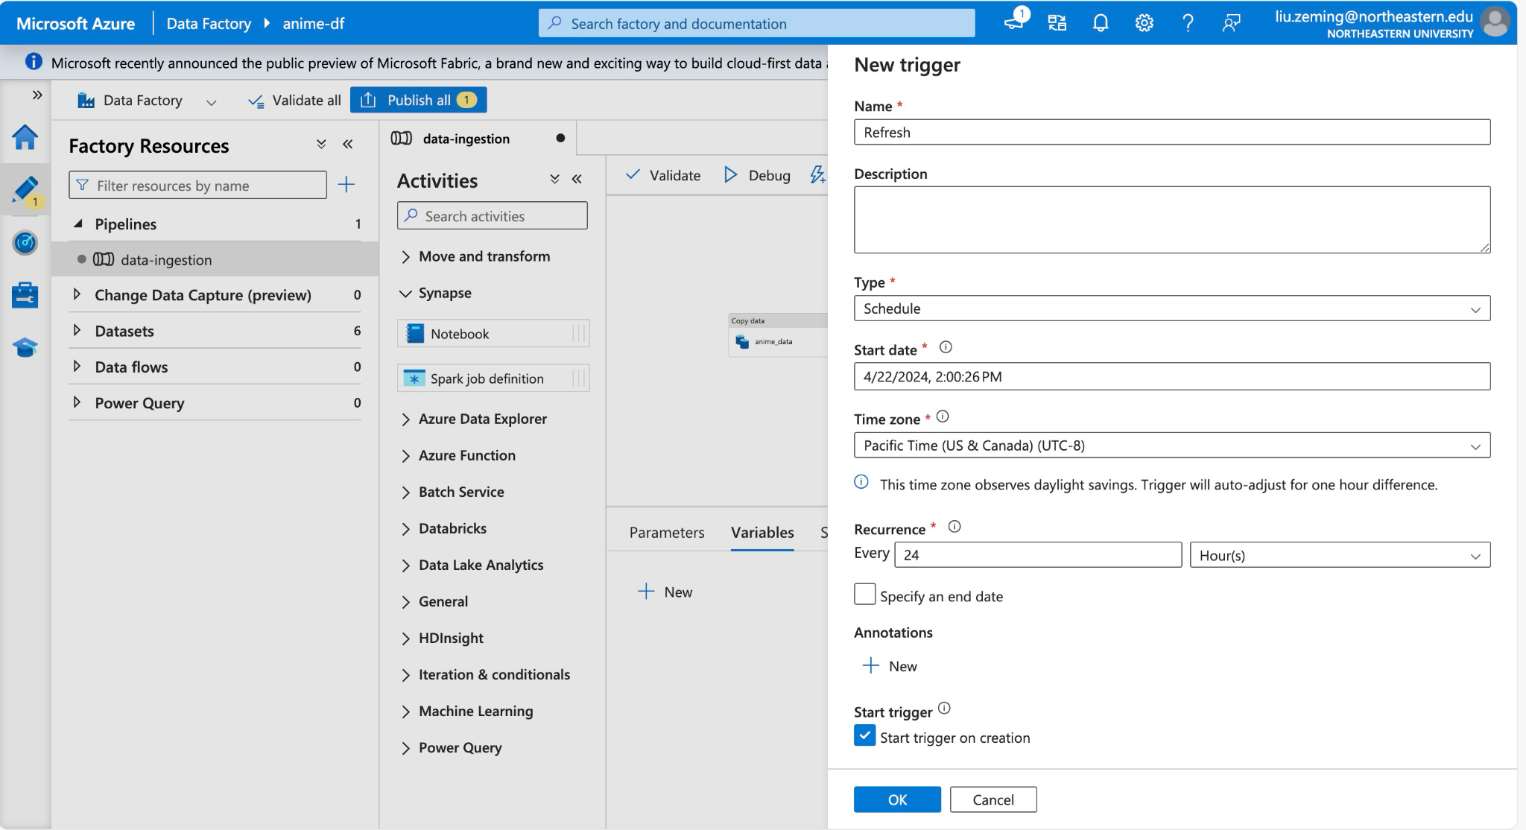
Refresh

Slide 20
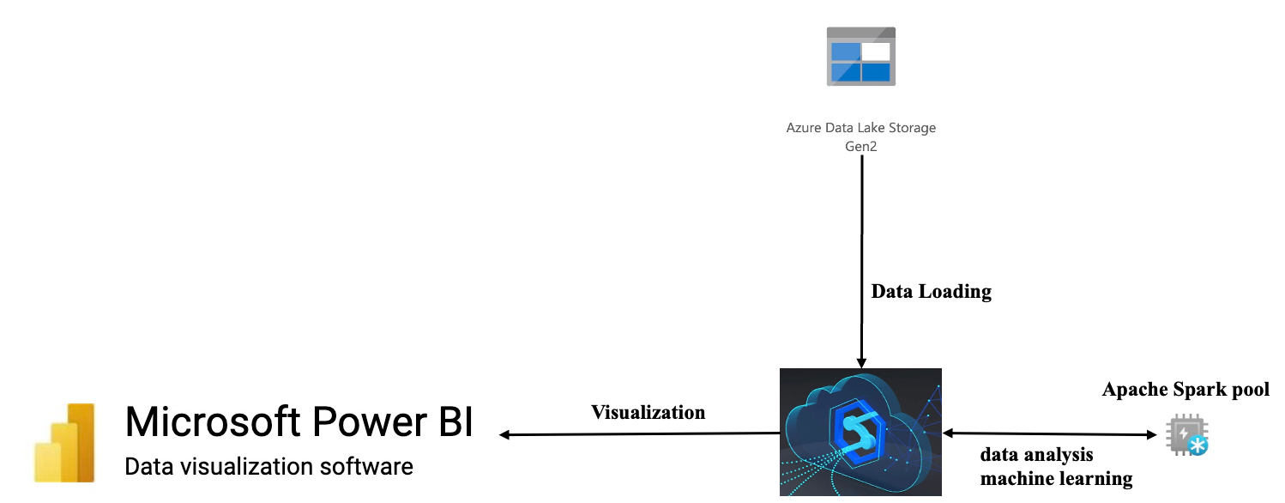
Analysis
Notes:
好的 当我们得到数据以后，我们将数据加载到azure synapse analytics 然后使用Google pyspark 对数据进行进一步的探索。
once we receive the data, we will load it into Azure Synapse Analytics and then use Google PySpark to further explore the data.

Slide 21
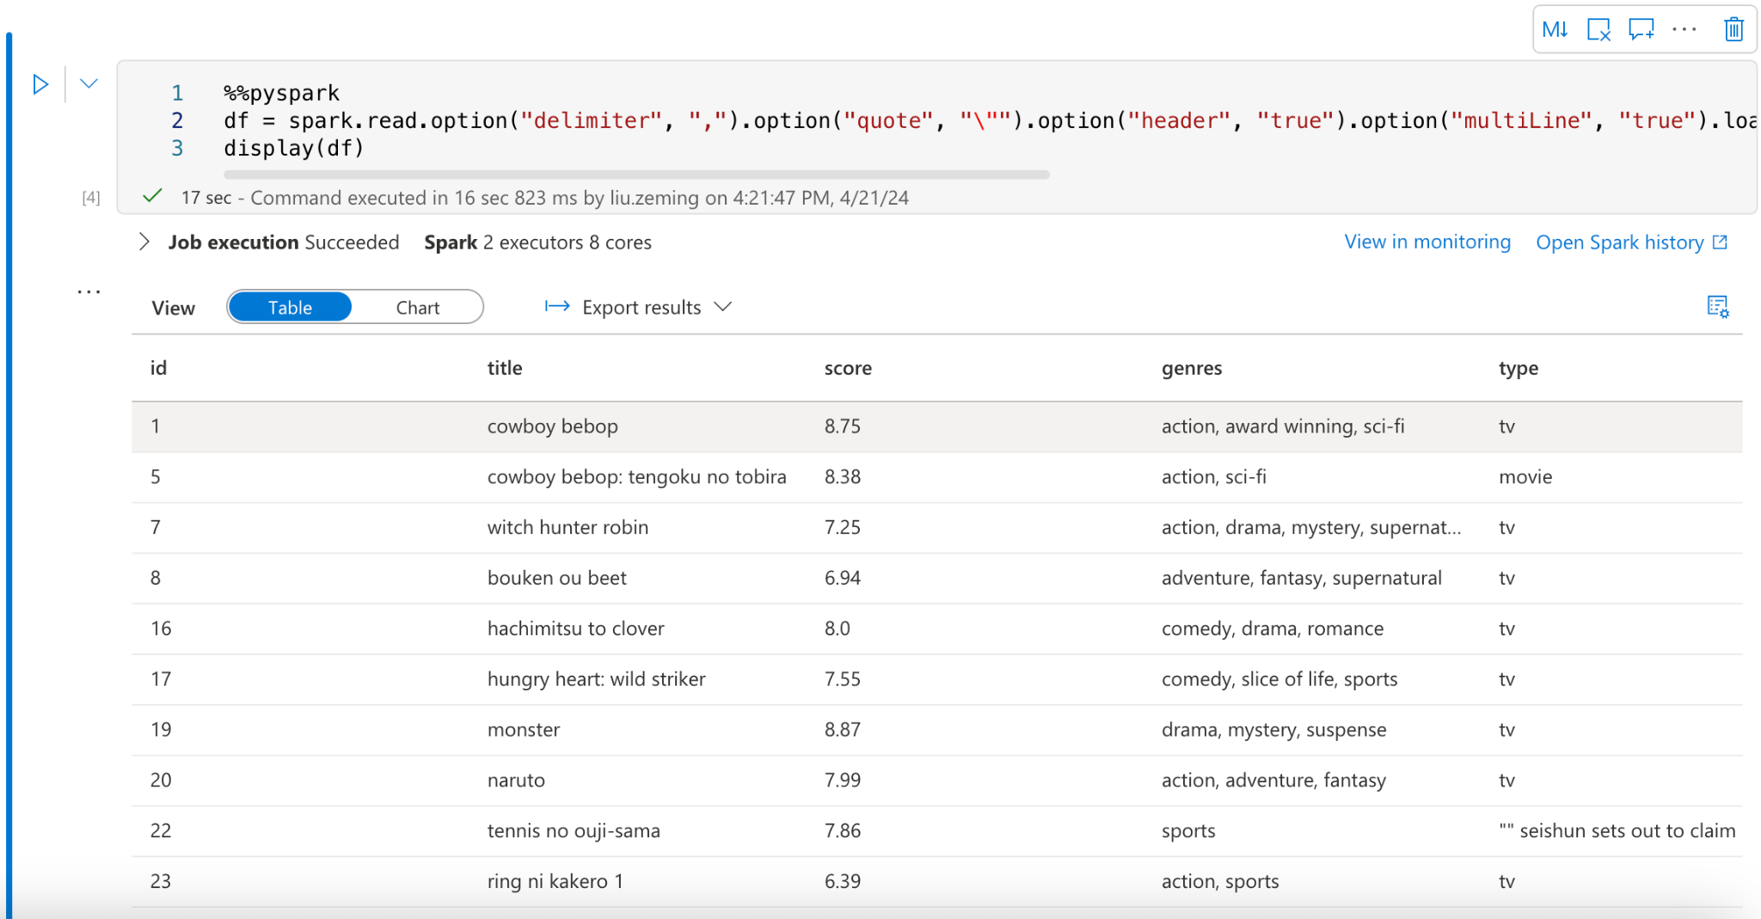
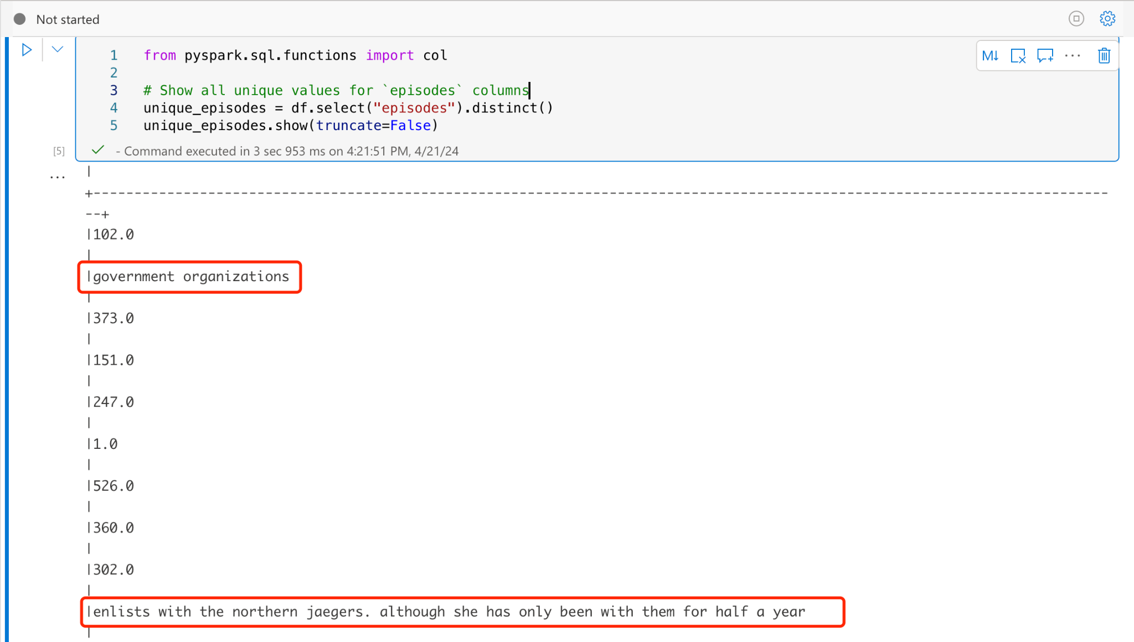
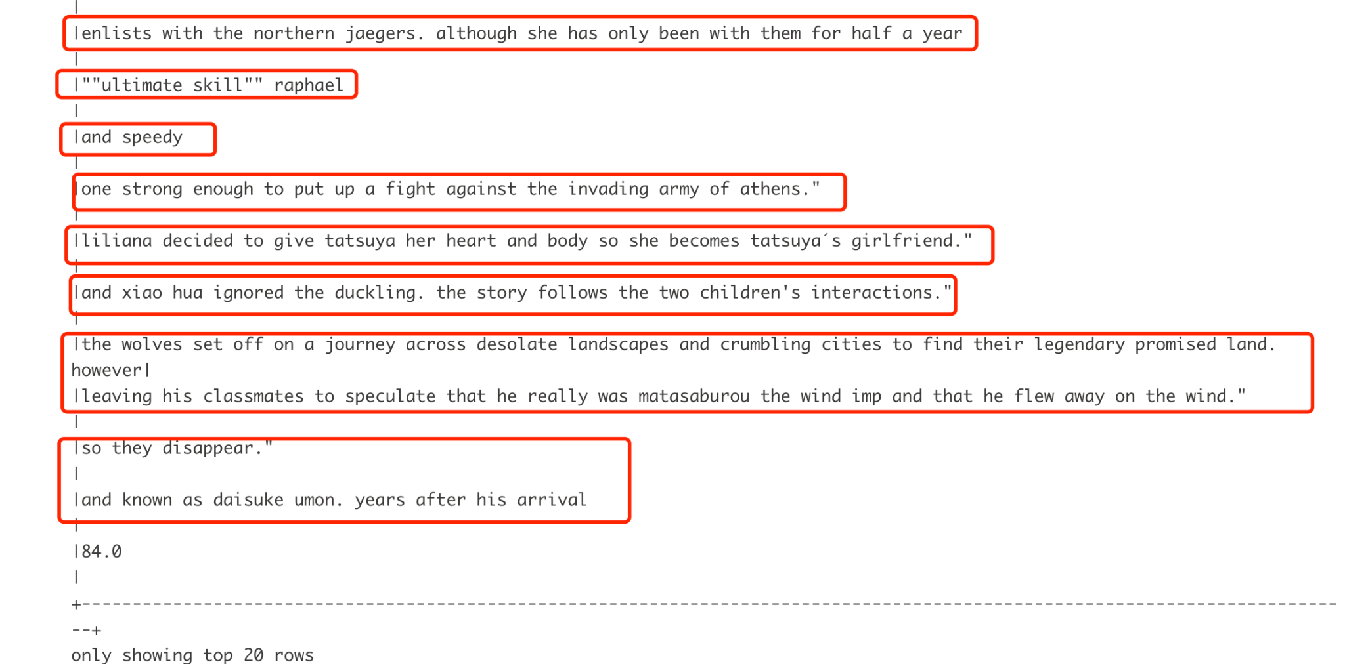
load data
Notes:
在我加载了数据后发现数据仍有不规则的情况，我们可以通过这两张图（图二）清楚的看到在episodes中任然存在着较多多文本数据，（理论上episodes列应该全部是整数），这可能是因在之前的过程中解析数据存在这一定的错误， 这意味着可能这一行的数据都存在着格式的错误，所以我们要做的是找出这些行并将其删除
After loading the data, I found that the data still had irregularities. We can clearly see from these two images (Image 2) that there is still a considerable amount of textual data in the episodes column, which should contain only integers. This may be due to errors in parsing the data in earlier processes, suggesting that the entire row of data may have format errors. Therefore, our task is to identify these rows and delete them.

Slide 22
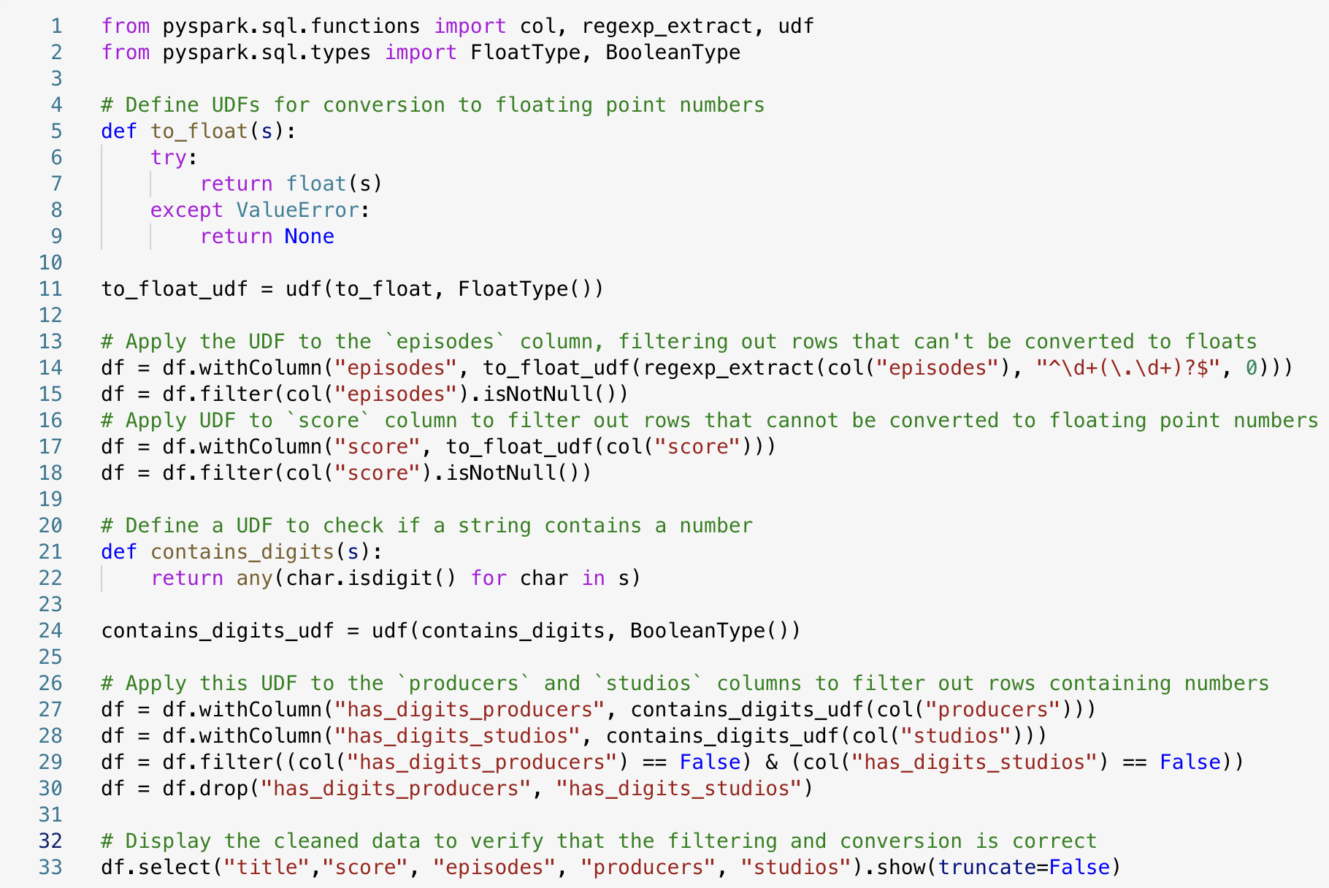
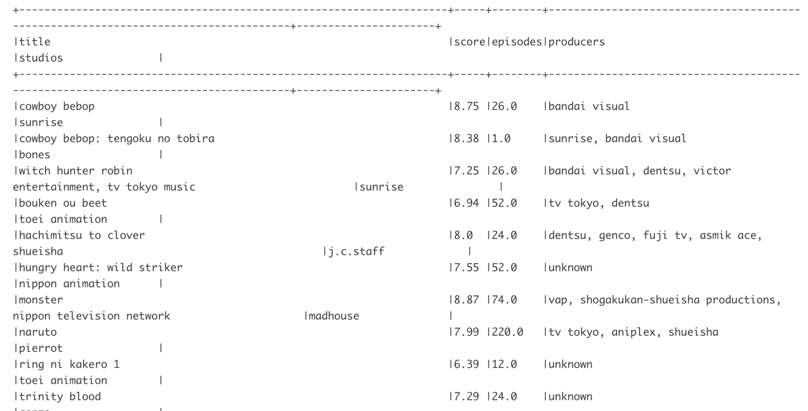
data cleaning
Notes:
在操作的过程中，我发现，这一列值的格式是文本格式，针对这种情况我们首先定义了一个函数UDF，将所有的数值转化为浮点数，如果出现error则标记为none,然后我们将这个函数应用到episodes这一列，再将无法转换为浮点数的行过滤掉。 因为在之后的数据处理的过程中我发现score也存在着同样的问题，所以我将UDF同理应用到了score这一列。
在之后和分析过程中我还发现还存在这一些本该为文本格式的列如producers、studios混入了一些不规则的数据，比如数字，或者日期，那么针对这种情况，我们又定义了一个定义检查字符串中是否包含数字的UDF然后应用到对应的列。 然后显示清洗后的数据，确认过滤和转换是否正确。
In the process of operation, I found that the format of the values in this column is text format, for this situation we first defined a function UDF, all the values will be converted to floating-point numbers, if there is an error, then marked as none, and then we will apply this function to the episodes of this column, and then can not be converted to floating-point number of rows filtered out. Because in the process of data processing after I found that the score also has the same problem, so I will UDF similarly applied to the score of this column.
In the process of analyzing the data, I also found that there are some columns that should be in text format, such as producers, students, mixed with some irregular data, such as numbers, or dates, so for this case, we defined a definition to check whether the string contains numbers in the UDF and then apply it to the corresponding columns.
Then display the cleaned data to confirm that the filtering and conversion is correct.

Slide 23



Splitting Fields
Notes:
简单的清洗过数据后我们发现在我们的数据中又一些列存在着复合字段，如图所示。为了方便我们之后的分析，所以我们需要将其拆开。 首先使用 split 函数将这个字符串拆分成一个数组，然后使用 explode 函数将数组中的每个元素转换为单独的行。 我们继续进行下一步分析 然后我们将所得到的清理过后的数据集储存的storage account中，以便之后使用powerbi进行可视化分析，可视化的部分等下会由我的组员来详细介绍。
After simply cleaning the data we found that there are compound fields present in some more columns of our data, as shown in the figure. In order to facilitate our subsequent analysis, so we need to split it.
First use the split function to split the string into an array, and then use the explode function to convert each element of the array into a separate row.
Then we store the cleaned dataset in a azure storage account for later visualization using powerbi, the visualization part will be described by my team members later.

Slide 24



Network Analysis
Notes:
我们继续来进行下一部分的分析：Network Analysis。 为了分析制作公司和工作室之间以及它们与动画作品之间的关系分析，我们对数据集中的关系数据进行深入的网络分析。
首先为了更好的分析，我们需要向之前一样，将制作公司和工作室这两列的数据进行拆分，结果如左图所示
然后我们创建制作公司和工作室与动画作品之间的基本连接，再通过统计每个实体（制作公司或工作室）与多少个不同动画作品有关联来计算度（Degree）。我认为这种方法追直接的识别了最活跃的实体，即那些参与动画作品最多的制作公司和工作室。 我们可以看到如“Toei Animation”和“Sunrise”等是动画行业中知名的大型工作室，其高度表明了它们广泛的业务覆盖。但我认为这不一定意味着它们制作的动画质量最高。这种方法更多关注于参与度而非作品的品质。
为了更深入的分析来挖掘数据中的复杂关系，我们在次基础之上又创建一个加权网络，其中边的权重是相关动画的平均评分和流行度。
相比之前的方法，此方法则关注于实体的平均作品质量（通过评分体现），从而给出了一个关于哪些制作公司或工作室制作的作品平均评分最高的视角。例如，“Miracle Robo”和“Quaras”顶部的排名表明尽管它们可能不是最活跃的制作单位，但它们参与的作品质量极高。
结合这两种方法，可以为动画行业的投资者或决策者提供全面的分析：
参与度分析（方法一）有助于了解行业中最活跃的玩家。
质量分析（方法二）则帮助识别那些虽然参与不多，但提供高质量内容的制作公司或工作室。
这样的信息可以帮助行业内的公司或投资者做出更明智的投资决策，比如选择与哪些工作室合作，或者在哪些工作室上投资，以达到预期的市场影响力和收益回报。
Let's move on to the next part of the analysis: Network Analysis. In order to analyze the relationship analysis between production companies and studios and between them and animation works, we carry out an in-depth network analysis of the relational data in the dataset.
First of all, for a better analysis, we need to split the data of the two columns of production companies and studios as we did before, and the result is shown in the left figure.
Then we create basic connections between production companies and studios and animation works, and then calculate the degree (Degree) by counting how many different animation works each entity (production company or studio) is associated with. I think that this method identifies the most active entities directly, i.e. the production companies and studios that are most involved in animation works.
We can see that studios such as "Toei Animation" and "Sunrise" are large and well known studios in the animation industry, and their high degree of involvement indicates their wide business coverage. But I don't think this necessarily means that they produce the highest quality animation. This approach focuses more on engagement than on the quality of the work.
In order to dig deeper into the data to uncover complex relationships, we build on top of this by creating a weighted network where the edges are weighted by the average rating and popularity of the animation in question.
In contrast to the previous method, this method focuses on the average quality of the entity's work (as reflected by the ratings), thus giving a perspective on which production companies or studios produce the highest rated work on average. For example, the top rankings of Miracle Robo and Quaras indicate that while they may not be the most active production entities, the quality of the work they are involved in is extremely high.
Combining these two methods provides a comprehensive analysis for investors or decision makers in the animation industry:
Participation analysis (method one) helps to understand the most active players in the industry.
Quality analysis (method two), on the other hand, helps to identify production companies or studios that are not very involved but provide high-quality content.
Such information can help companies or investors in the industry make more informed investment decisions, such as choosing which studios to partner with or invest in to achieve the desired market impact and return on revenue.

Slide 25



Building a Predictive Model
Notes:
为了进一步探究影响评分的相关因素，我们Build a Predictive Model
首先，我们选取了一些对score影响比较大的因素（'producers', 'studios', 'type', 'source'）然后对其进行编码，并创建了特征向量。之后将这两个步骤封装在管道内，方便应用。
然后我们将数据集以8:2的比例分割为训练数据和测试数据，以确保模型在足够大的数据集上训练，同时还保留了一部分数据用于检验模型的泛化能力。
To further explore the factors influencing the ratings, we build a predictive model.
First, we selected some factors that have a significant impact on the score ('producers', 'studios', 'type', 'source'), encoded them, and created feature vectors. These two steps were then encapsulated within a pipeline for easy application.
Next, we split the dataset into training and testing data at an 8:2 ratio to ensure that the model is trained on a sufficiently large dataset, while also reserving a portion of the data to test the model's ability.

Slide 26




Building a Predictive Model
Notes:
接下来我们分别使用了Random Forest、Random Forest 以及线性回归三个模型进行了预测和评估，我们使用了（Root Mean Squared Error, RMSE）作为评估标准，得到的结果分别为，0.518562、0.458022、0.781675。
我们可以看出在三种模型中，梯度提升树（GBTRegressor） 表现最好，其次是 随机森林（RandomForestRegressor），而 线性回归模型 的表现相对较差。这些结果为你选择最合适的模型提供了明确的数据支持：
梯度提升树模型的 RMSE 最低（0.458022），这表明该模型在处理当前数据集时，预测误差最小，模型的拟合效果最好。
随机森林模型也表现不错，RMSE 达到0.518562，仅次于GBT模型，说明它同样能够较好地捕捉数据中的复杂模式。
线性回归模型的 RMSE 较高（0.781675），可能是因为数据特征与评分之间存在非线性关系，这使得简单的线性模型无法很好地拟合数据。
Next, we used three models for prediction and evaluation: Random Forest, Gradient Boosting Tree (GBTRegressor), and Linear Regression. We used Root Mean Squared Error (RMSE) as the evaluation criterion, with results of 0.518562, 0.458022, and 0.781675, respectively.
We observed that among the three models, the Gradient Boosting Tree (GBTRegressor) performed the best, followed by the Random Forest (RandomForestRegressor), while the Linear Regression model performed relatively poorly. These results provide clear data support for choosing the most suitable model:
The Gradient Boosting Tree model had the lowest RMSE (0.458022), indicating that this model had the smallest prediction error and the best fit for the current dataset.
The Random Forest model also performed well, with an RMSE of 0.518562, ranking second to the GBT model, showing that it could also capture the complex patterns in the data well.
The Linear Regression model had a higher RMSE (0.781675), possibly due to the nonlinear relationships between data features and scores, which made the simple linear model unable to fit the data well.

Slide 27

Ensemble Learning Model
Notes:
Ensemble Learning Model
在得到三个model的预测集过后我们又对三个模型进行了简单集成和bagging集成
结果回顾与解读
左边的图片为
简单平均集成模型：
RMSE = 0.507526
这种方法将三个不同模型（随机森林、GBT、线性回归）的预测结果进行简单平均。结果显示，集成方法能有效提高预测的准确性，比单一模型的结果更好。
右边的图片为
Bagging 集成模型：
RMSE = 0.504686
通过训练多个随机森林模型的变体（每个都在训练数据的不同子集上训练），并计算它们预测结果的平均值，得到了稍微更低的 RMSE。这表明Bagging方法可以有效地减少模型预测的方差。
This image shows the Simple Average Ensemble Model:
RMSE = 0.507526
This method takes a simple average of the prediction results from three different models (Random Forest, GBT, Linear Regression). The results demonstrate that the ensemble method can effectively improve the accuracy of predictions, performing better than any single model.

Slide 28

Ensemble Learning Model
Notes:
This image shows the Bagging Ensemble Model:
RMSE = 0.504686
By training variants of multiple Random Forest models (each trained on different subsets of the training data) and calculating the average of their prediction results, a slightly lower RMSE is achieved. This indicates that the Bagging method can effectively reduce the variance of model predictions.

Slide 29

Visualization

Slide 30

genre-based analysis

Slide 31


type-based analysis

Slide 32

studio-based analysis

Slide 33

Animation data dashboard

Slide 34
Thank you

